Slide 1
Representation and
Academic Societies at HSU
hallamstudentsunion.com
@hallamsu

Slide 2
Become a Course Rep
Want to make your mark?
Course Reps gather thoughts and opinions from other students on their course and discuss their findings with staff to agree on how the course could be improved.
Join our community of Course Reps to learn new skills, meet new friends, and change your course for the better.
Time commitment: 2 – 4 hours a month
Sign up here: hallamstudentsunion.com/reps
hallamstudentsunion.com
@hallamsu

Slide 3
Why become a Course Rep?
1
Gain formal recognition for your contribution, including through the new Course Rep Accreditation Scheme
2
Extensive training and development opportunities
3
Lots of support and guidance from University & Students' Union staff
Sign up here: hallamstudentsunion.com/reps

Slide 4
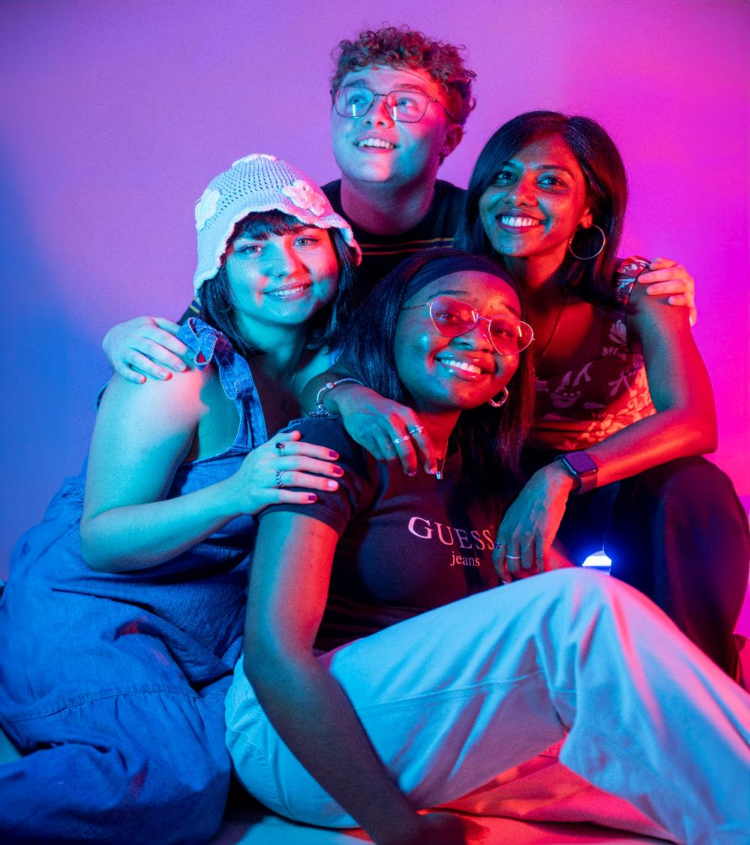
Join an
Academic Society
Academic Societies at Hallam Students’ Union aim to bring together like-minded individuals based on a shared interest of your area of study.
They organise events with guest speakers and course relevant trips & activities.
Visit their dedicated webpage on the SU website that includes their social media links, upcoming events, and more.
hallamstudentsunion.com/societies
hallamstudentsunion.com
@hallamsu

Slide 5
Contact the teams
Representation: studentreps@shu.ac.uk
Academic Societies: activitiesadmin@shu.ac.uk
hallamstudentsunion.com
@hallamsu

