Slide 1
Volunteering as a Society
In this Session:
Find out how your society could build your skills and get amazing experience for your CV, all while making a difference to those who need it most
Notes:
Introduce myself
What I do
How long at SU
Previous work

Slide 2
Who are you?
Notes:
Lets quickly go around the room, introduce yourself, tell us what society you’re from and one cause that you’re passionate about.

Slide 3
What we will cover:
1. What is Volunteering
2. Why Societies should Volunteer
3. What types of Volunteering your society can do
4. How we can help you to Volunteer.

Slide 4
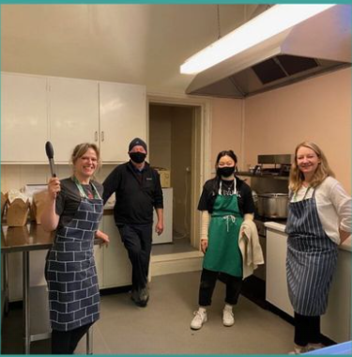
What is volunteering?
Volunteering England says:
“Any activity that involves spending time, unpaid, doing something that aims to benefit the environment or someone (individuals or groups) other than, or in addition to, close relatives”.
Notes:
We see volunteering as:
An opportunity to spend time outside of your studies making a difference – to yourself and to others
Did you know
That you’re already a volunteer?
Society committee members are classed as volunteers, which means you can already start logging your hours and working towards volunteering awards. ( We will show you how to do this later )
Hallam Societies have a proud tradition of volunteering, we will share lots of examples with you.

Slide 5
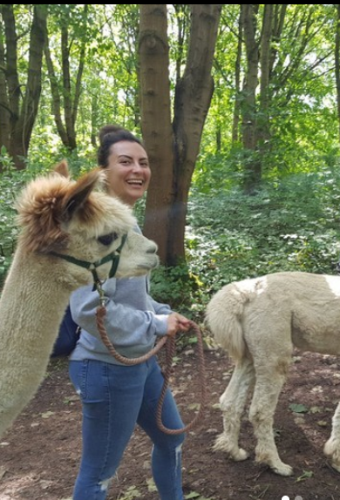
Why should you volunteer as a society?
As a team building exercise
As a social activity
To benefit a cause close to the heart of your society
Raise the profile of your society
To gain new skills
To build your CV
To meet new people
To help the community
To work towards volunteering awards
The community impact award at Societies Ball
To see new parts of the city
To explore what matters to you

Slide 6
What skills can you gain by volunteering?
Volunteering is a great way to build:
Team work skills
Communications skills
Problem solving skills
Project management skills
Partnership working skills
Leadership skills
Networking skills
and many more...

Slide 7
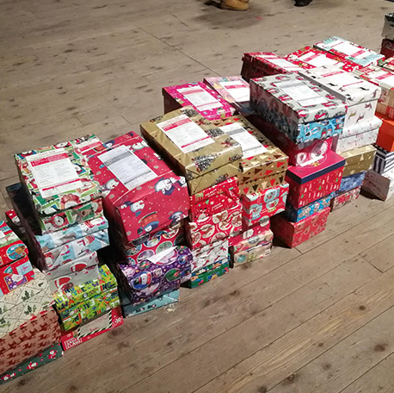
What can you do as a society?
Group Volunteering and Community Action
Outreach
Fundraising, Appeals and Raising Awareness
Notes:
Group Volunteering and Community Action
Attending or creating long term volunteering opportunities or one-off volunteering events as a society, for example working on a restoration or conservation project, or helping out at a local charity event.
Outreach
Sharing your skills as a society with a group in the community, for example delivering a session at a school or community hall.
Fundraising, Appeals and Raising Awareness
Putting on your own volunteering events to raise money/awareness for a charity partner, or taking part in an appeal such as the shoebox appeal.

Slide 8
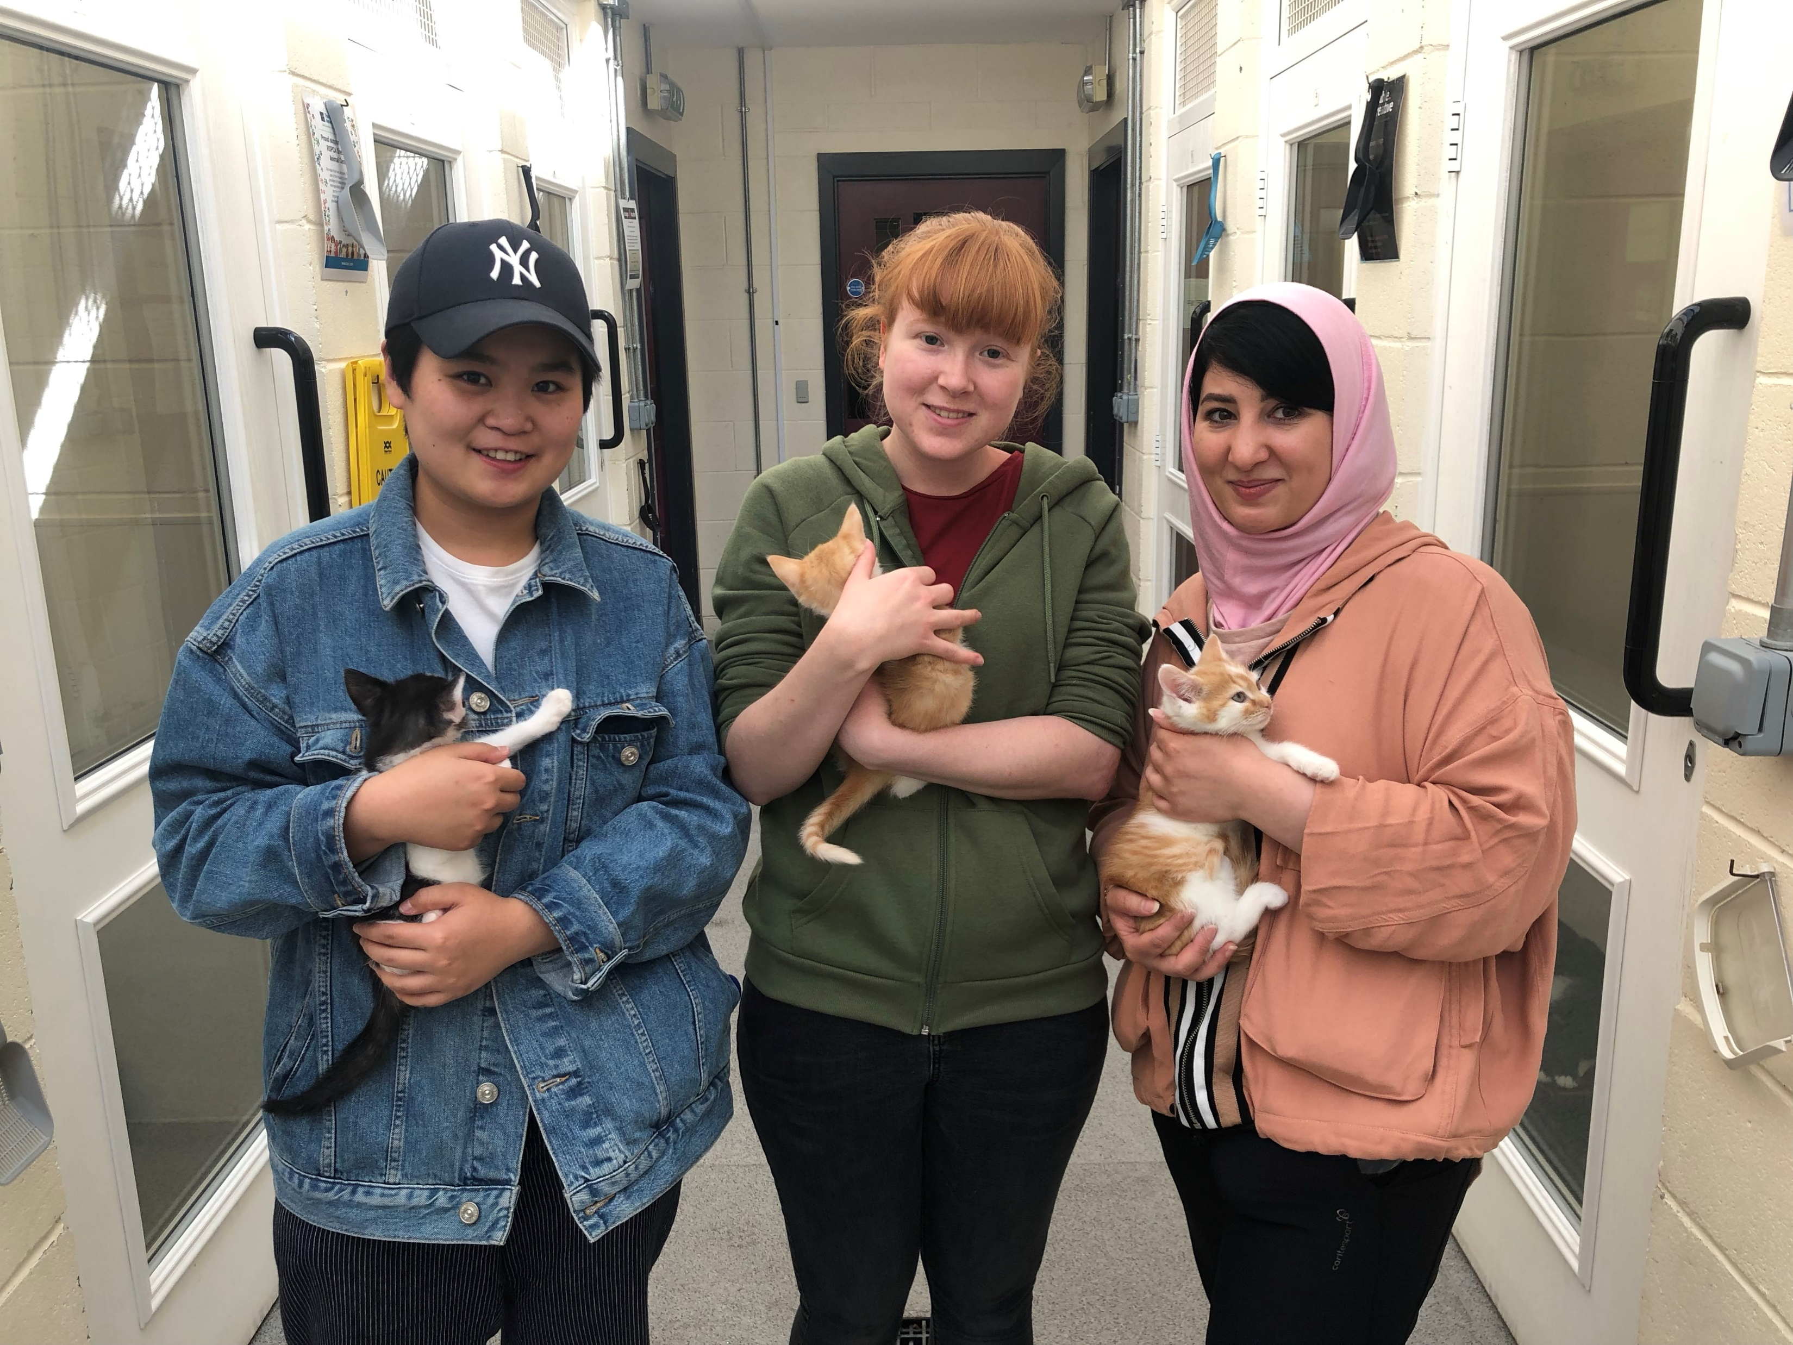
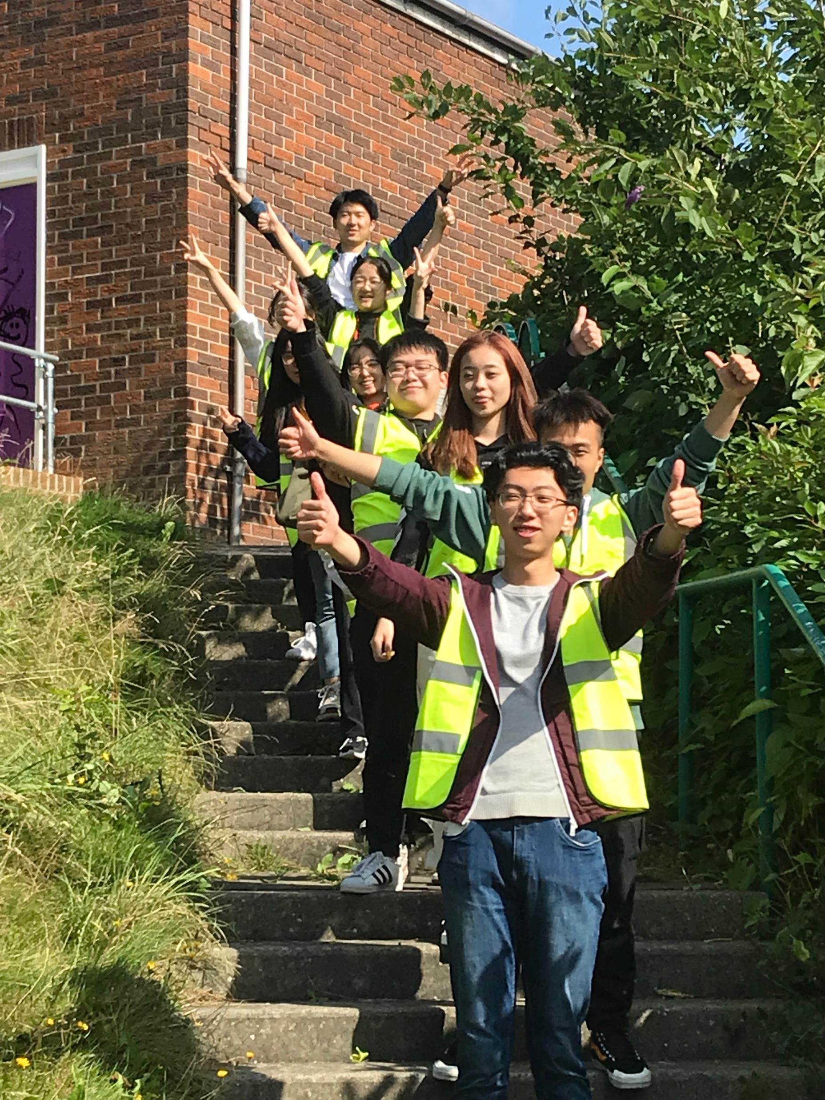
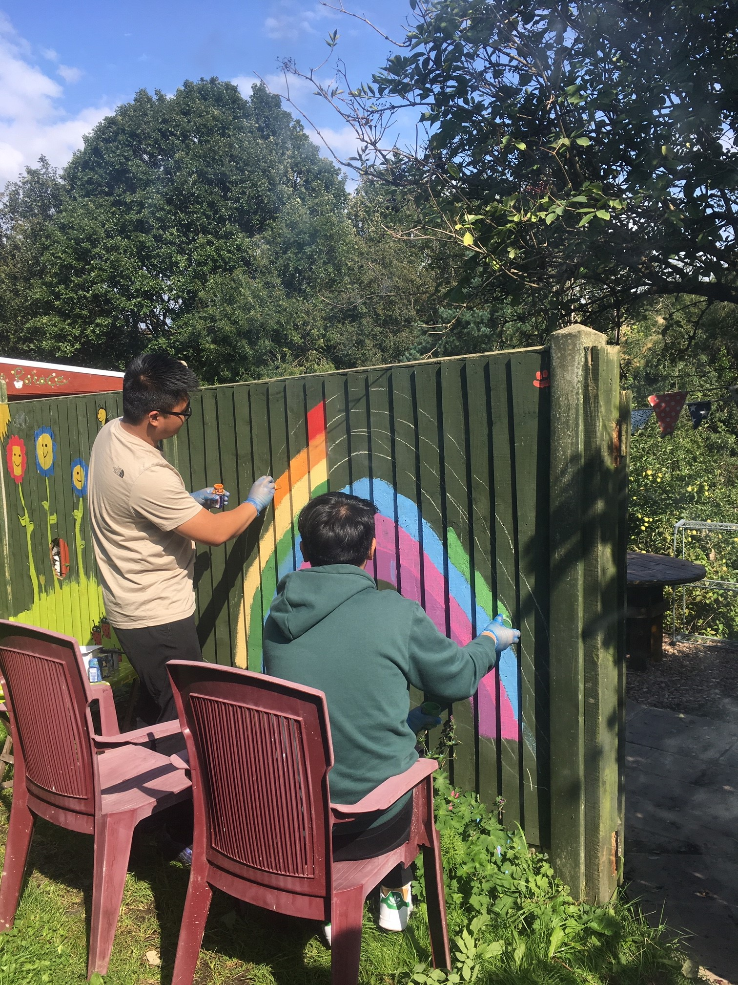
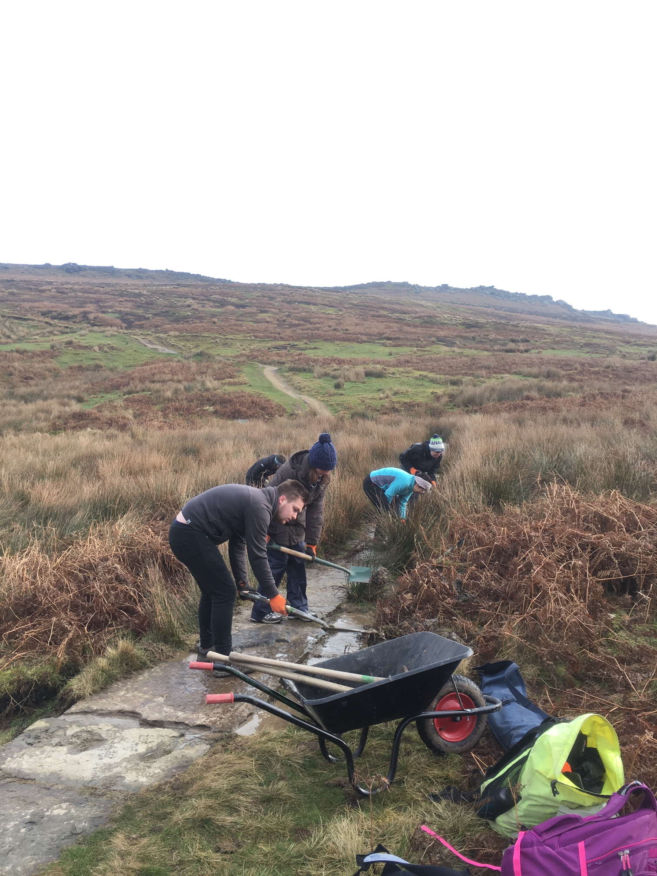
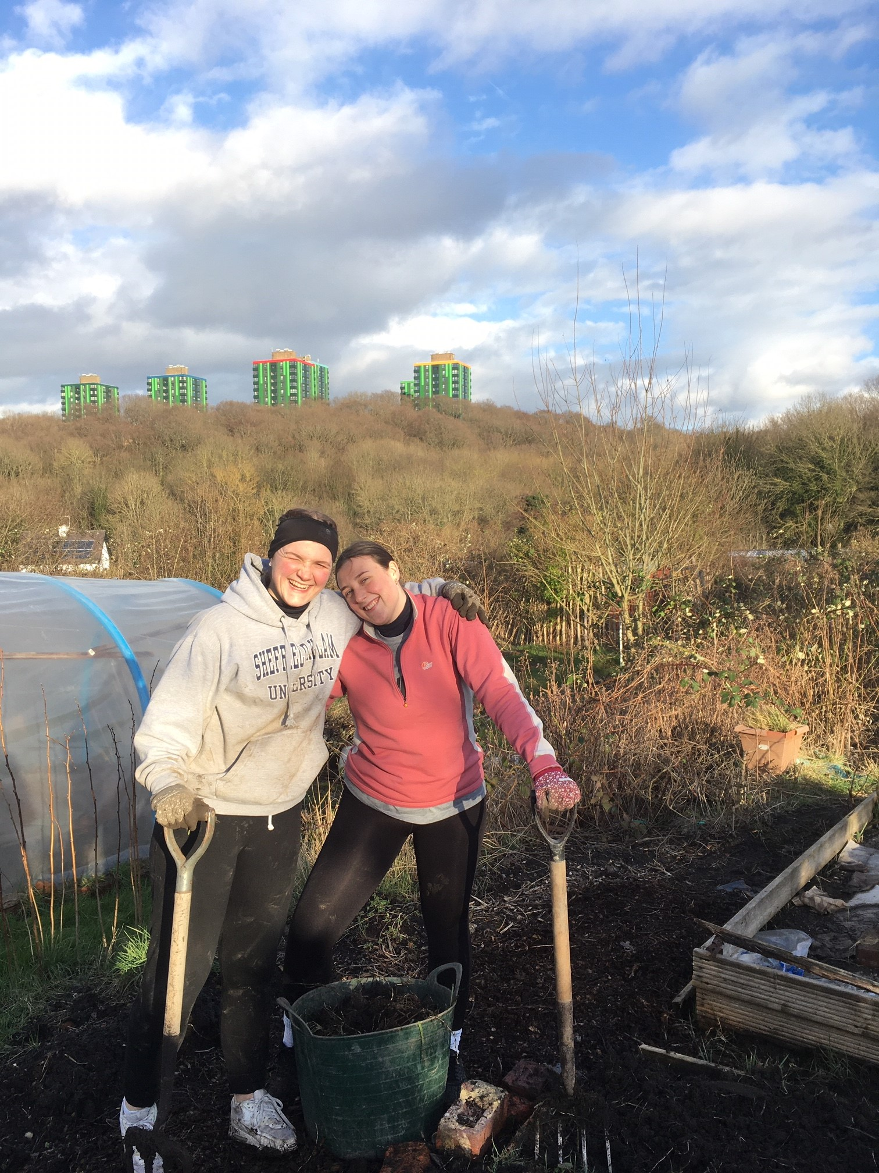
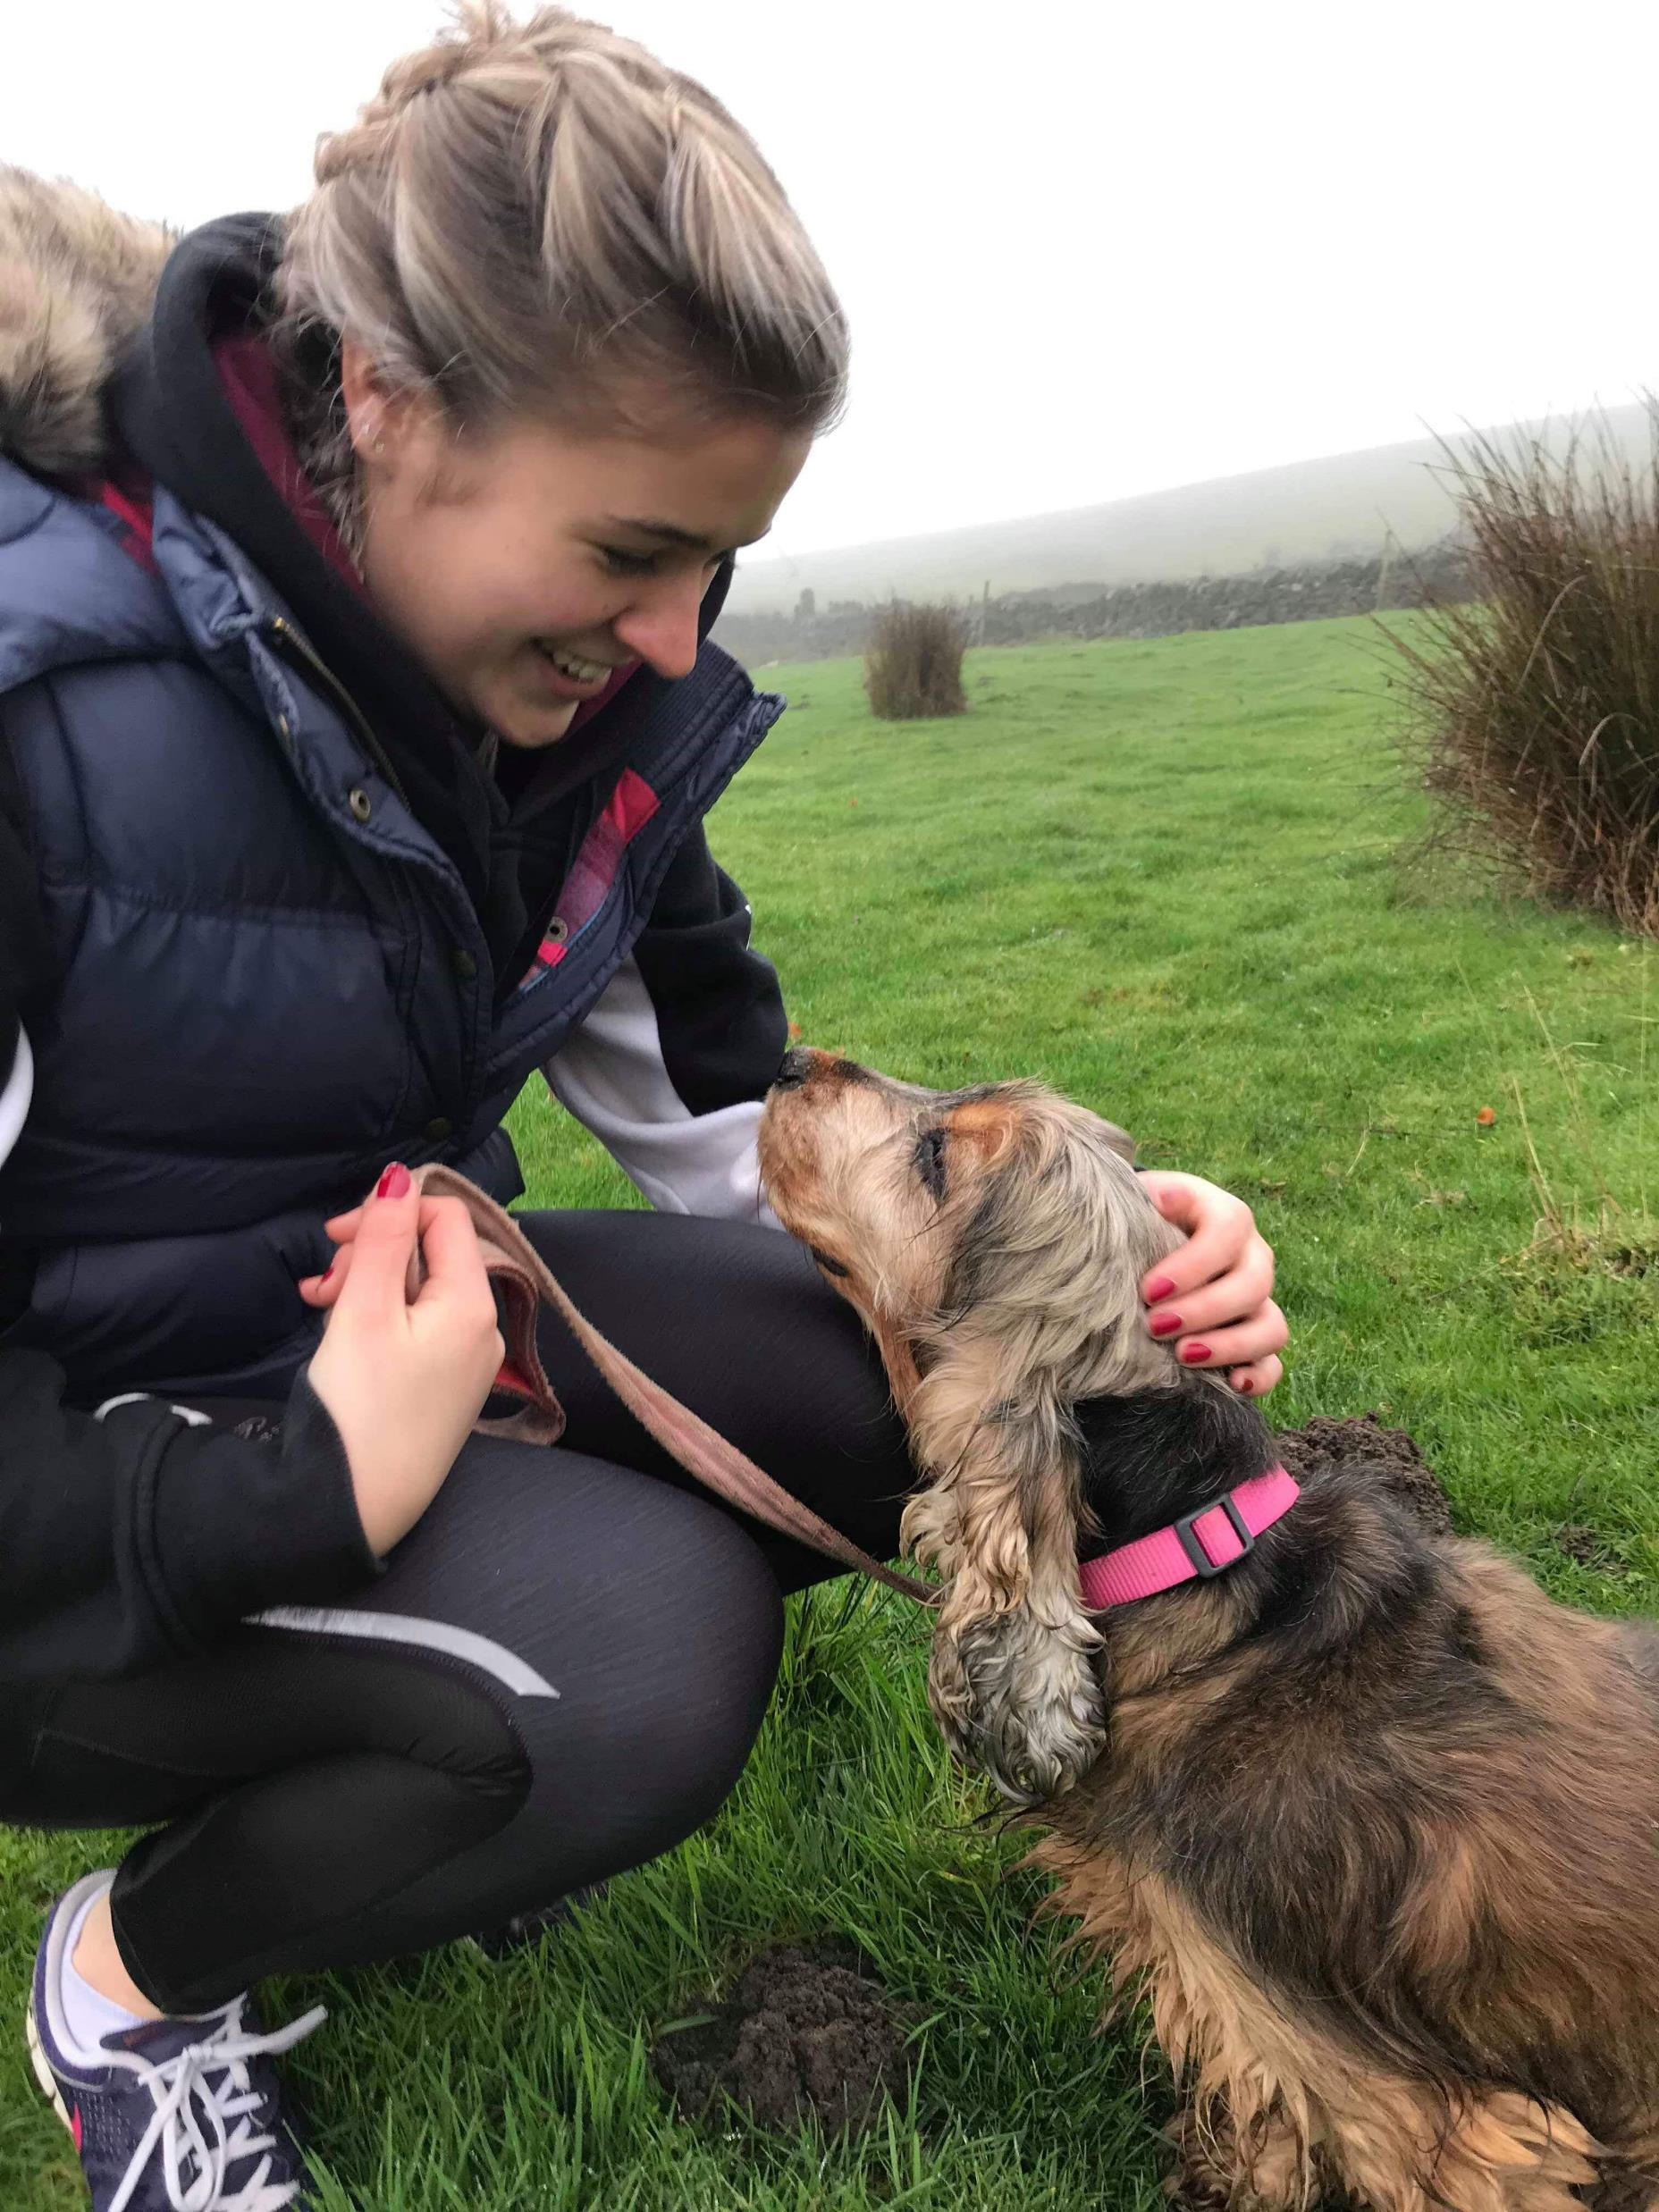
Previous Group Volunteering Days
Notes:
What have Societies done in the past?
Examples include...
Dog walking (Teambuilding)
Shoe Box appeal
Sports sessions at Zest / healthy eating sessions for kids, craft sessions and garden make overs
Sponsored Runs
Many bake sales
Walks in the lake district
RSPCA volunteer days (Teambuilding, Community Action)
Renovations of important Sheffield venues such as Abbeydale Picture House (Teambuilding, Community Action)
Biomedical Sciences Society did an outreach activity bringing STEM to young people in the community (Community Action, Outreach)
You could also use your skills as a group to get creative – for example make a video or flyer for a charity.
This year, we want to challenge you to get your society involved in volunteering, and see what a difference you can make as a team!

Slide 9
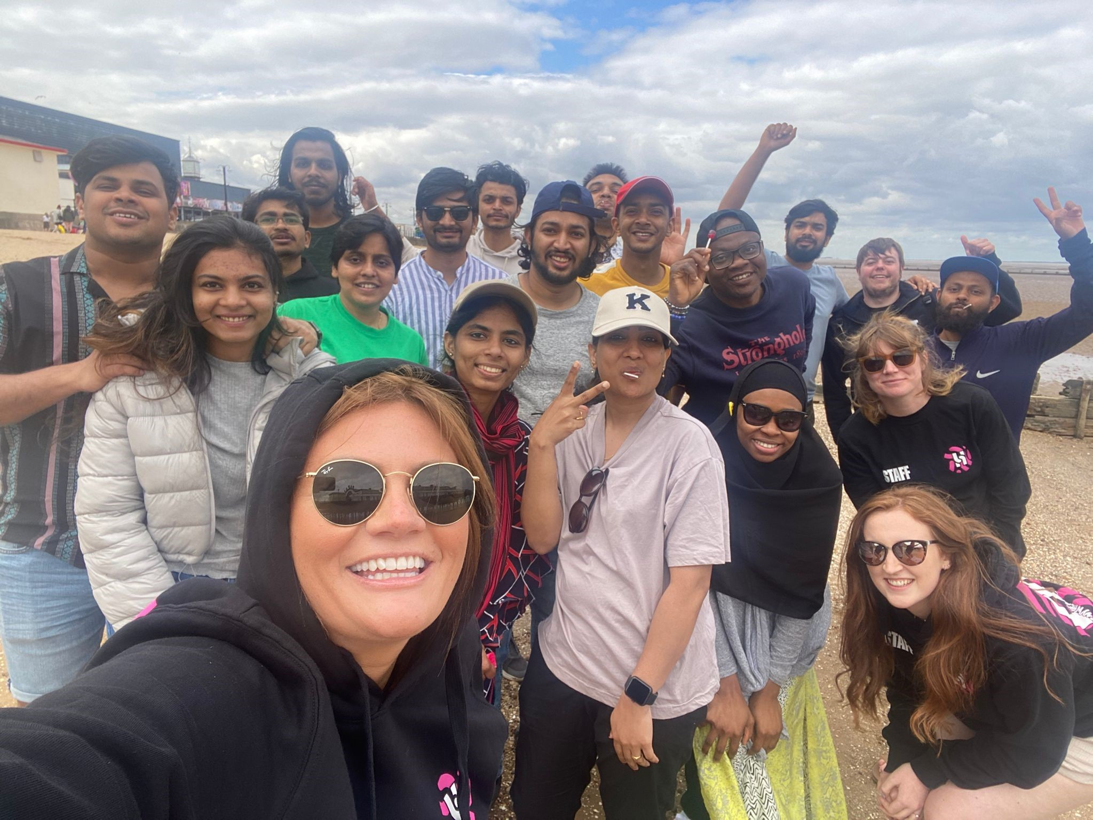
Beach Clean Day ‘22
Notes:
We can arrange bespoke volunteering days for you.

Slide 10
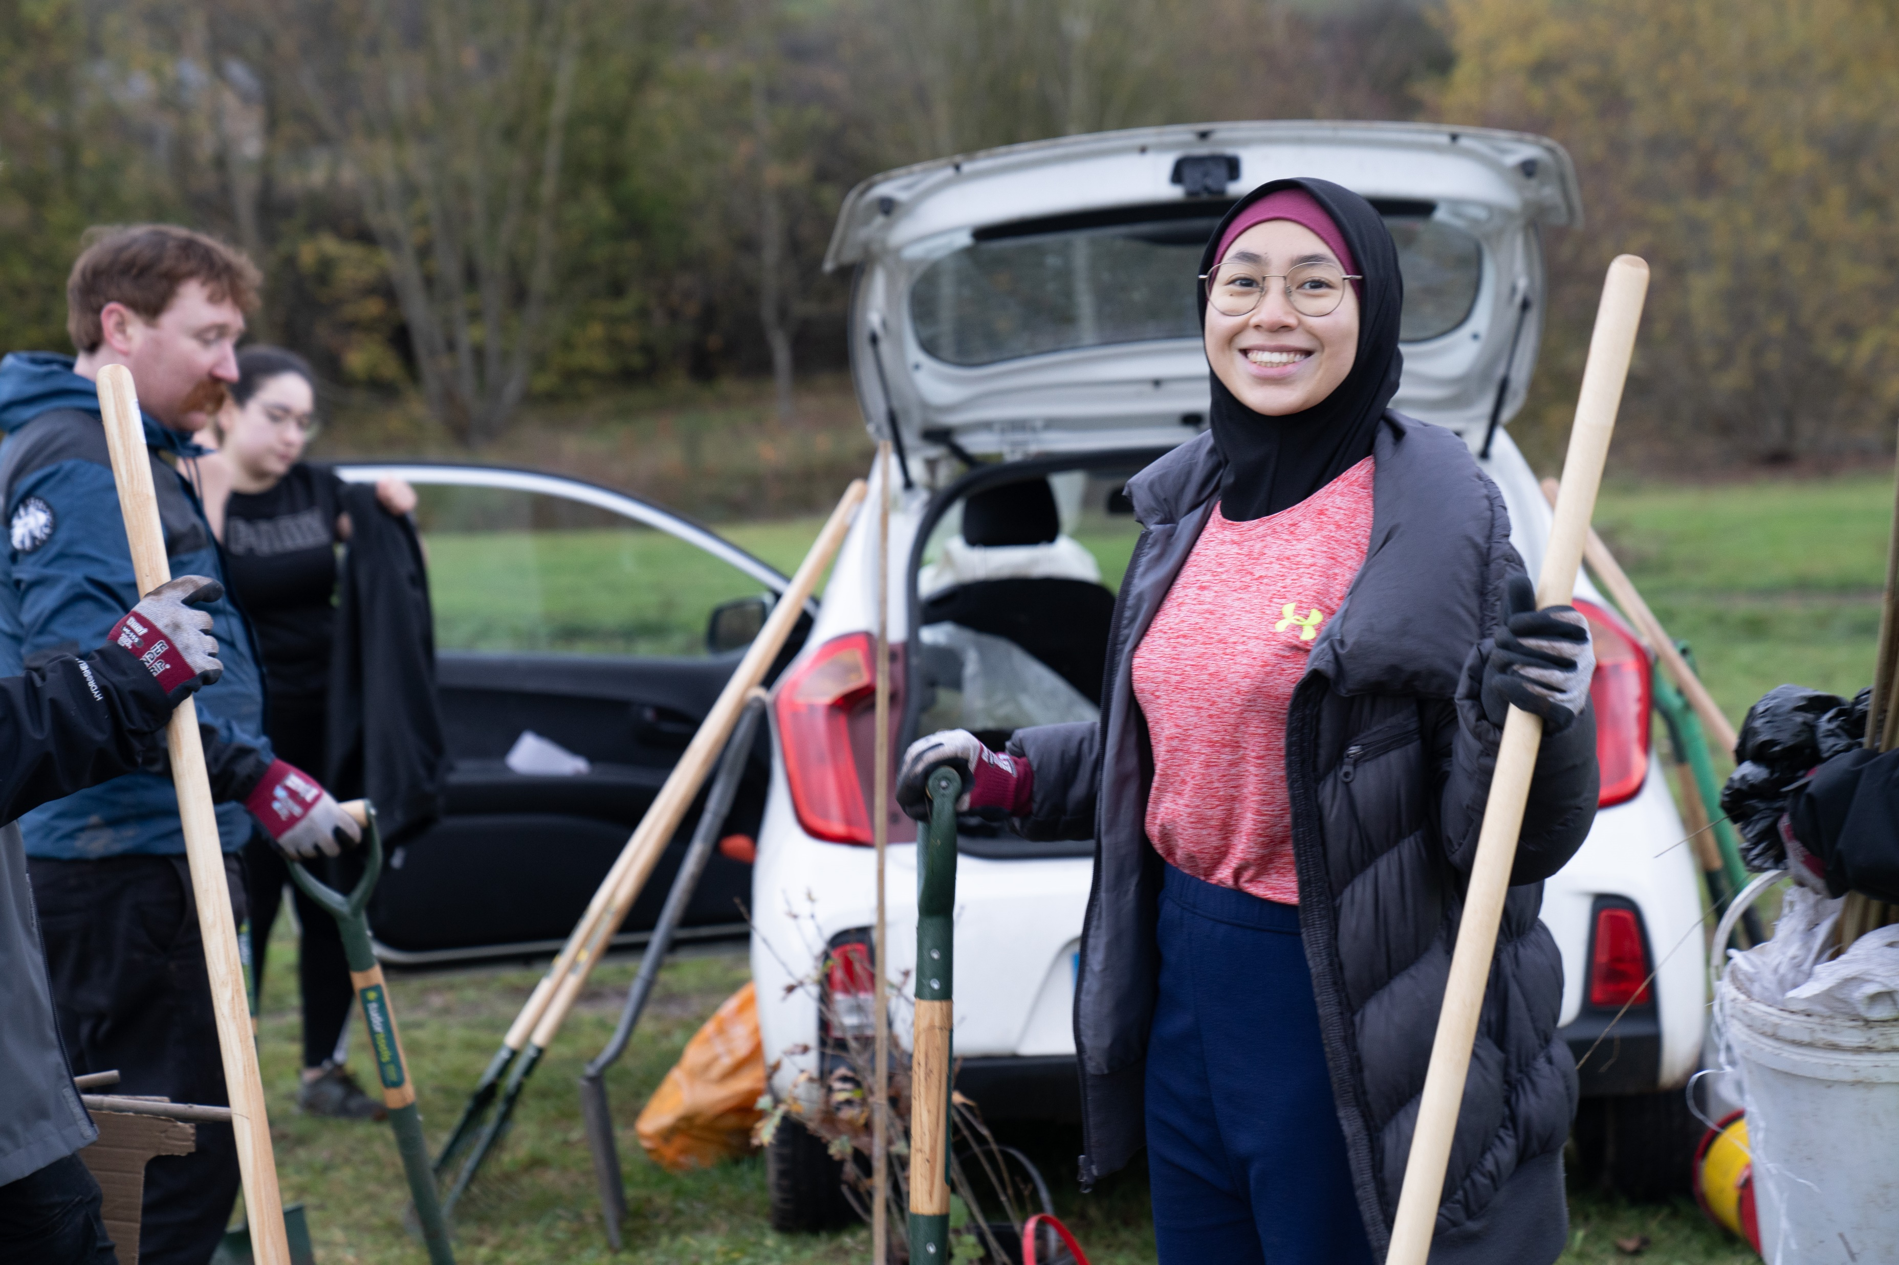
How does volunteering through the SU work?
Notes:
Through our team, volunteers can access:
Our volunteering brokerage system which currently has over 100 providers and 100 opportunities
Longer term opportunities
Give it a Go volunteering opportunities
SU organised volunteering events and activities
Come to us with a project, idea or cause you’d like to support
You can log your hours, keep a log of your skills and work towards volunteering awards (10, 50, 100 and 250 hours)

Slide 11
How can we help you?
Support you in finding opportunities through the brokerage or give it a go opportunities suitable for your society
Support you in connecting with a charity partner to create your own opportunities/events
Fundraising support – we can link you up with a cause in the community
Covering expenses
DBS Checks
Marketing and promotion for your volunteering activities
Help you plan a volunteering event or project
Help you connect with outreach partners such as schools or community centres
General advice and support – we’re here to help!
Notes:
Support you in finding opportunities through the brokerage or give it a go opportunities suitable for your society
Support you in connecting with a charity partner to create your own opportunities/events
Fundraising support?
Covering expenses
DBS Checks
Support with funding?
Marketing and promotion for your volunteering activities
Help you plan a volunteering event or project
Help you connect with outreach partners such as schools or community centres
General advice and support – we’re here to help!

Slide 12
Any questions?

