Slide 1
Committee Training
Freshers 2023

Slide 2
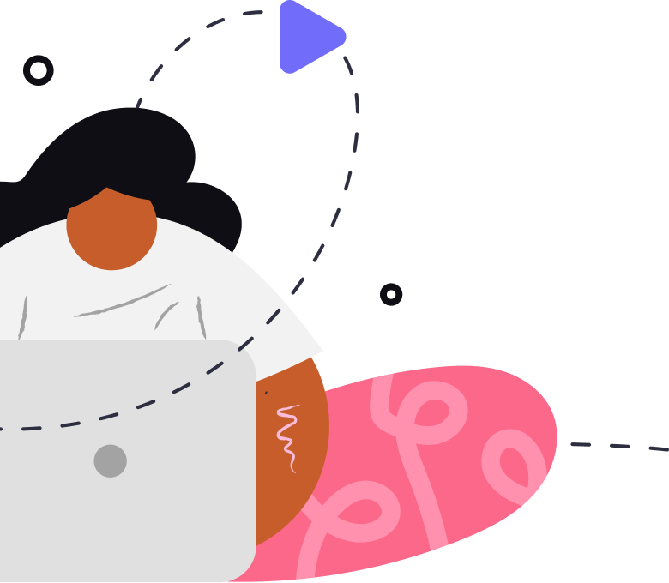
native believe in a world where every student organisation can provide an amazing campus culture and help their students have the best time at university.
‹#›

Slide 3
We’re here to help
Whatever the query you have, please never hesitate to get in touch and I will be happy to help
Hannah Woodruff
Senior Customer Success Manager
hannahwoodruff@native.fm
partner.native.fm
‹#›

Slide 4
native Events Platform

Slide 5
The native Admin Panel
The native Scanning App
Your Events Tech Package
This is where you will create events, list tickets and promote your events schedule.
This is also fully integrated with your MMS so that students can benefit from single sign on and you have access to reporting via MMS.
The native scanning app is free to download to your mobile device.
You can track sales, quickly scan in guests, view answers to questions, sell tickets in person and more using this app.
https://promoters.native.fm/
partner.native.fm
‹#›

Slide 6
Integrations

Slide 7
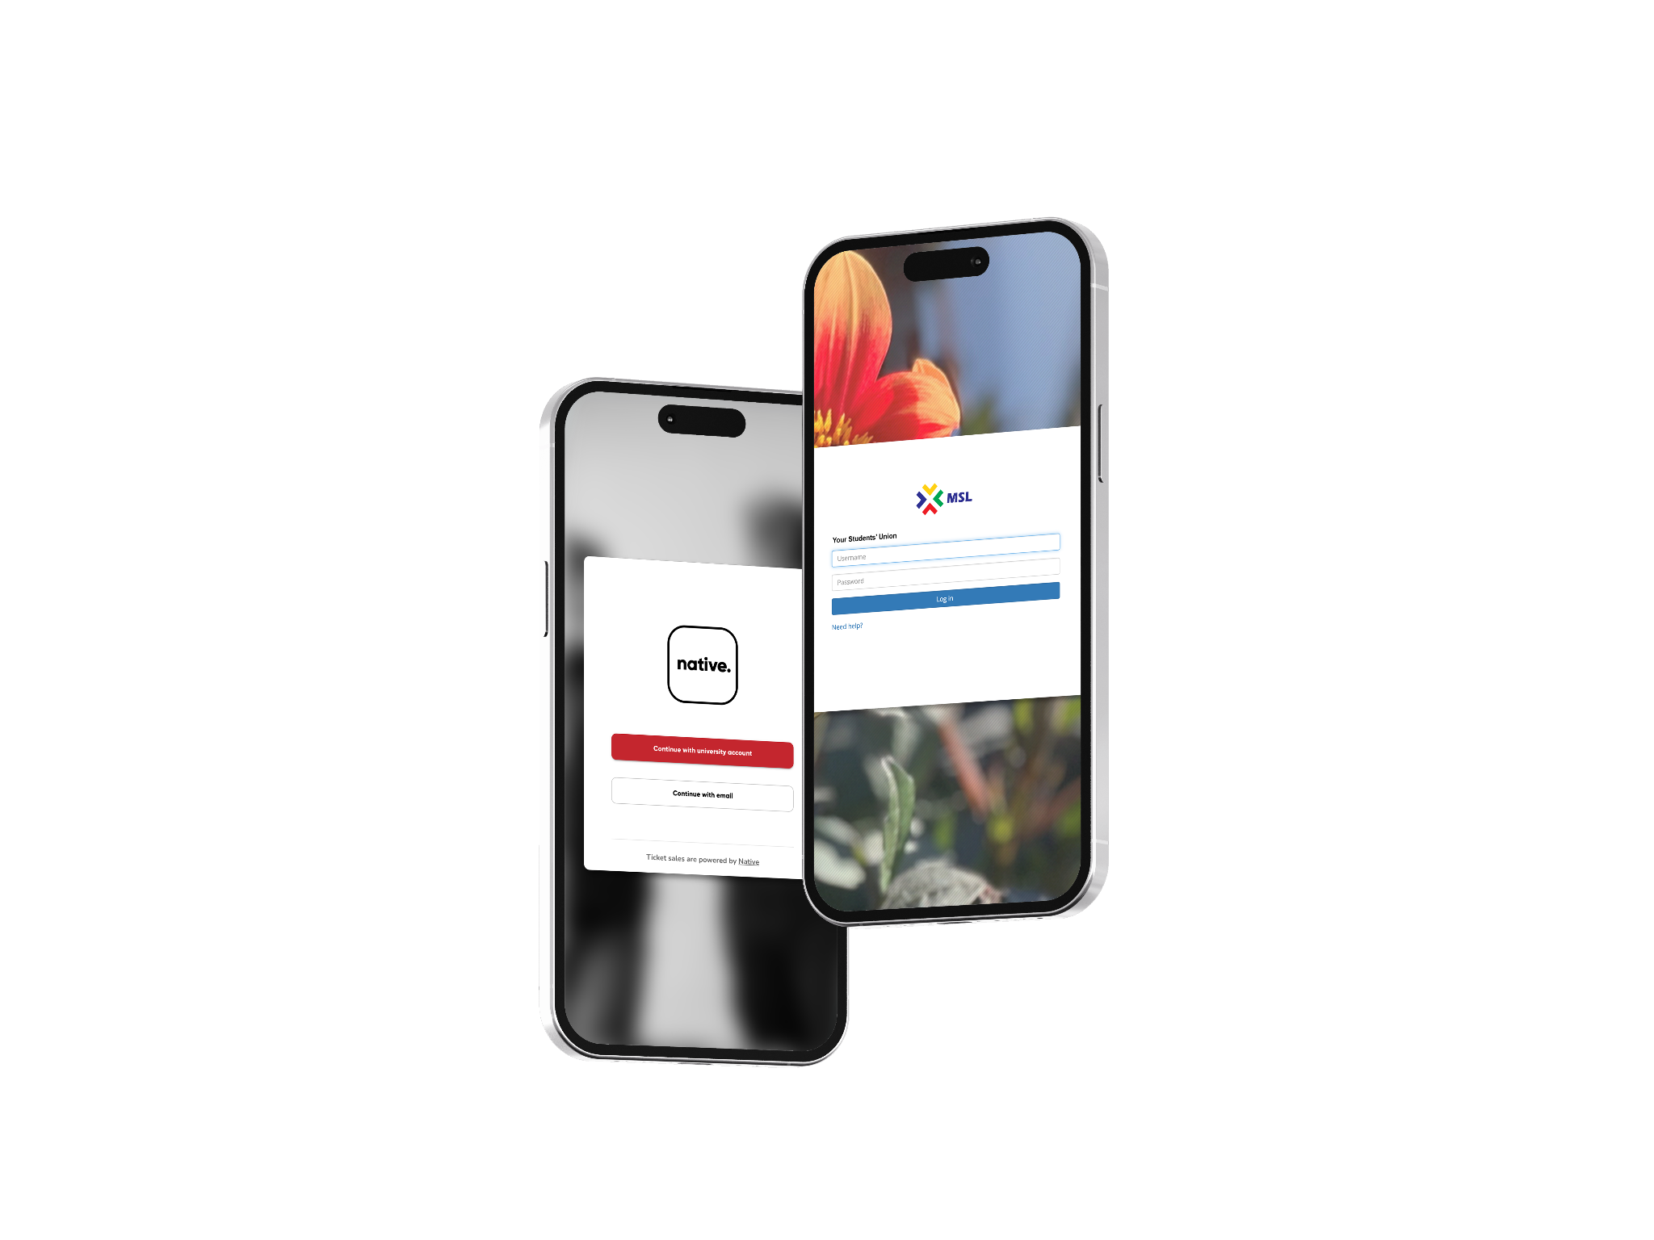
MSL integrations
Our MSL/native integration allows the following:
Students can sign up and log into native via their university credentials
Event listings and tickets are sent through to your existing MSL group page automatically
List student-only and member-only tickets on native
Send native ticket sale details to the Event ticket orders in MSL
Send native ticket sales to the student account section in MSL
partner.native.fm
‹#›

Slide 8
Events

Slide 9
Event Listing
You can add lots of different information to your events and easily manage your events on the control panel.
Event Date & Time
Group Page Only
Location - In person or Online
Event Types (Category, Genre, Tags, Artists)
Description and Image
Duplicate & Repeat events
‹#›

Slide 10
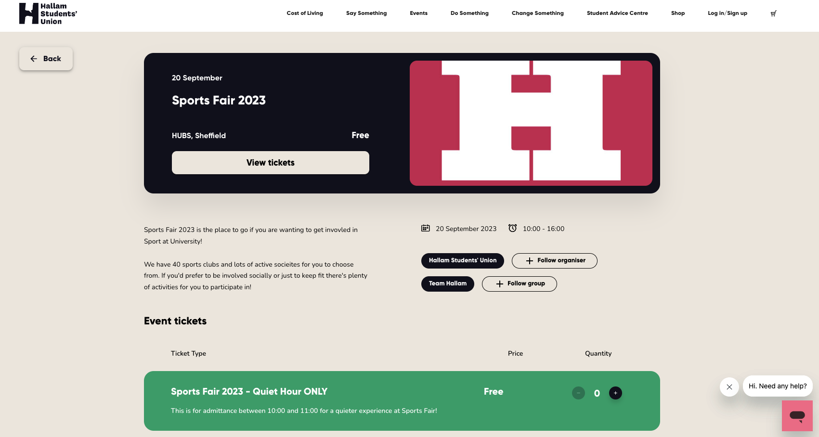
partner.native.fm
‹#›

Slide 11
Tickets

Slide 12
Ticket Creation
Free or paid, ticketing is full of features to help make booking attendance to events easier and better for students. Native allows you to:
Automate Capacity Tracking
Add Ticket Questions
Enable Promo Codes
Allow Ticket Transfers
Set Student & Member Only
Control Ticket Visibility e.g. on sale date or sold out
‹#›

Slide 13
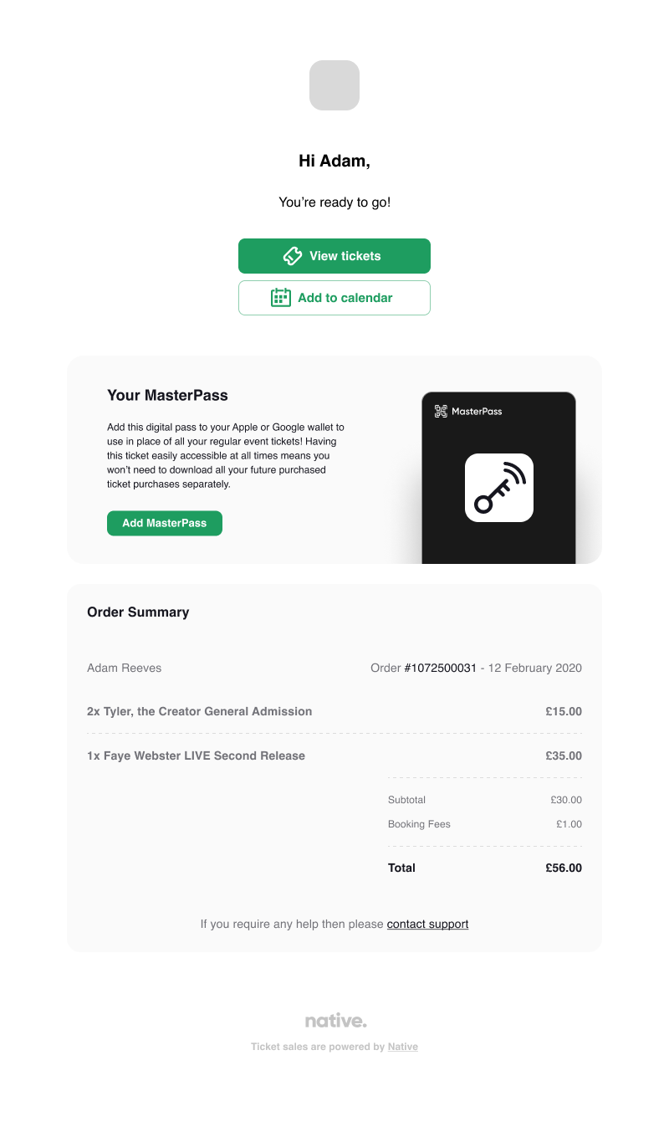
Ticket Purchase
A simple and speedy check out process for students
Confirmation email sent to user
Tickets also accessible via the native account
Master Pass is a unique QR code that can be downloaded to mobile wallets
partner.native.fm
‹#›

Slide 14
Attendance

Slide 15
Native Scanning App
Available for both iOS and Android, is a free tool that allows you to keep track of attendance at your events. You can scan tickets, see real-time attendance analytics, and record who attended after the event finishes. The app also lets you sell box office tickets effortlessly with a few taps.
Once you have activated your account, your login details will work with the scanning app!
partner.native.fm
‹#›

Slide 16
Feature Spotlight

Slide 17
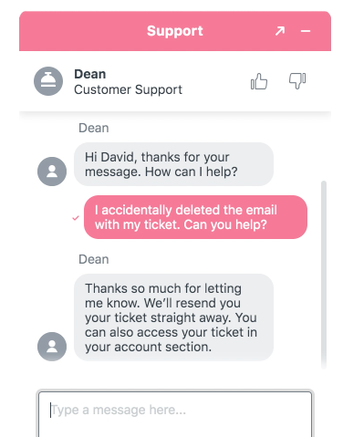
Customer Service
Chat
“
Received a lovely email stating my issue had been sorted, great service
We have a dedicated customer service team who provide out of hours support to students through freshers.
Any user can contact a member of our team via live chat or email with any queries they may have.
“
“
Very quick response, sorted my problem quickly & efficiently
“
“
Highly punctual, positive replies
“
partner.native.fm
‹#›

Slide 18
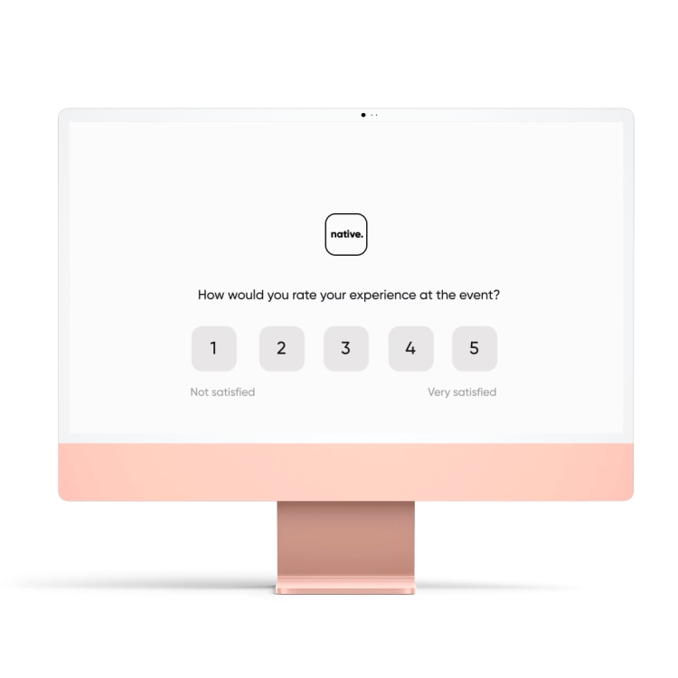
Feedback Surveys
Allow you to gather valuable insights into how students feel about the events you run.
Set up at event creation and toggle on or off
Delivered as automated emails, sent the morning after the event.
They include a thank-you-for-attending message, capture a satisfaction score question in the body of the email, which also links out to a more detailed online survey.
Survey data can then be found within the event details, where you’ll be able to track metrics such as NPS score, CSAT score and reply rate as well as see all individual feedback responses.
partner.native.fm
‹#›

Slide 19
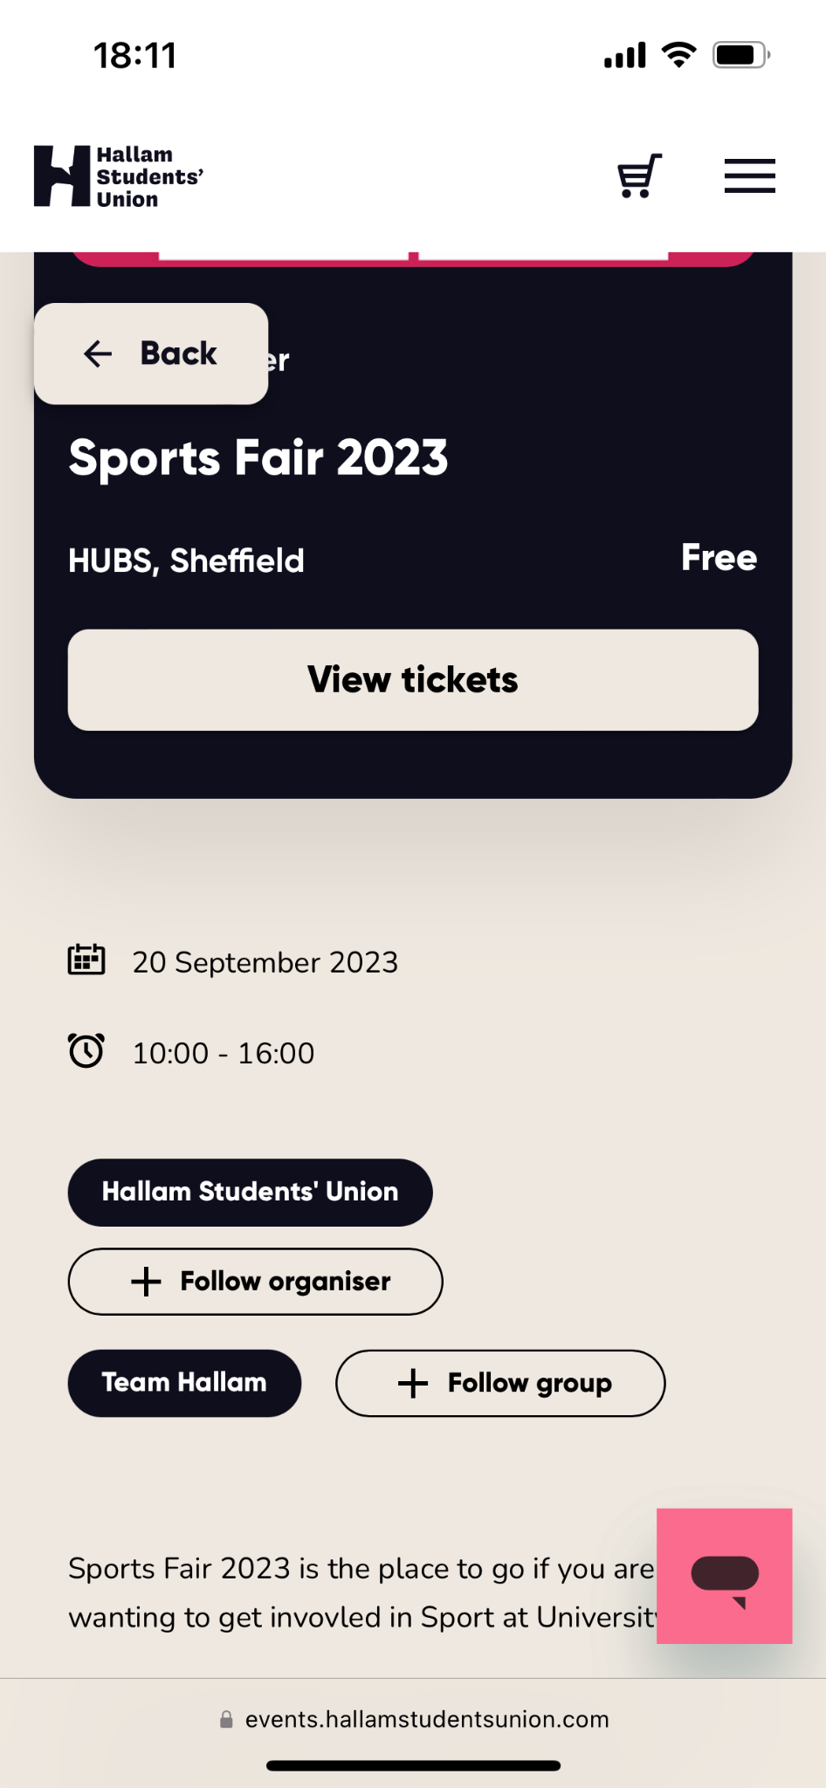
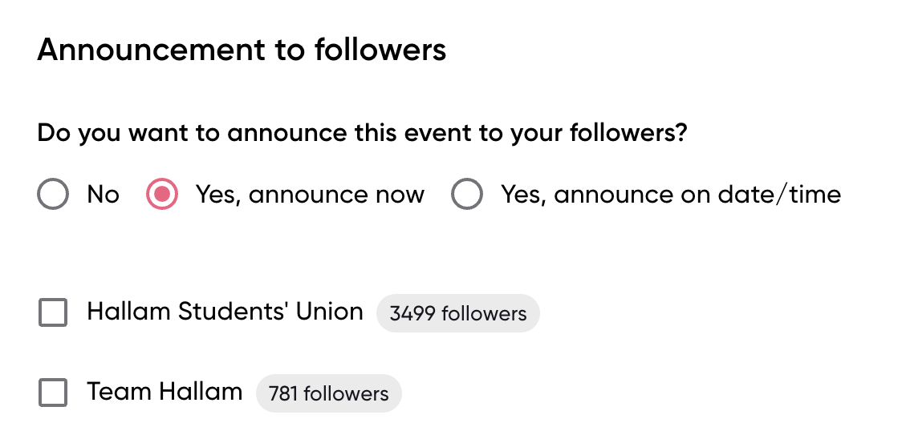
Following
Following is a free marketing tool for you to let your followers know about events you have coming up.
Students will always have the ability to unfollow so your followers will be your most engaged users and a group you can build during freshers to encourage loyalty.
‹#›
partner.native.fm
‹#›

Slide 20
New Notification
Customisable email to your chosen group of users
Previous Notifications
See emails sent in the past as well as who sent them
Notifications
1
2
Notifications are a quick and effective way to alert your chosen group of users out of four groups about service notifications such as a location change or event entry point
native.fm
‹#›

Slide 21
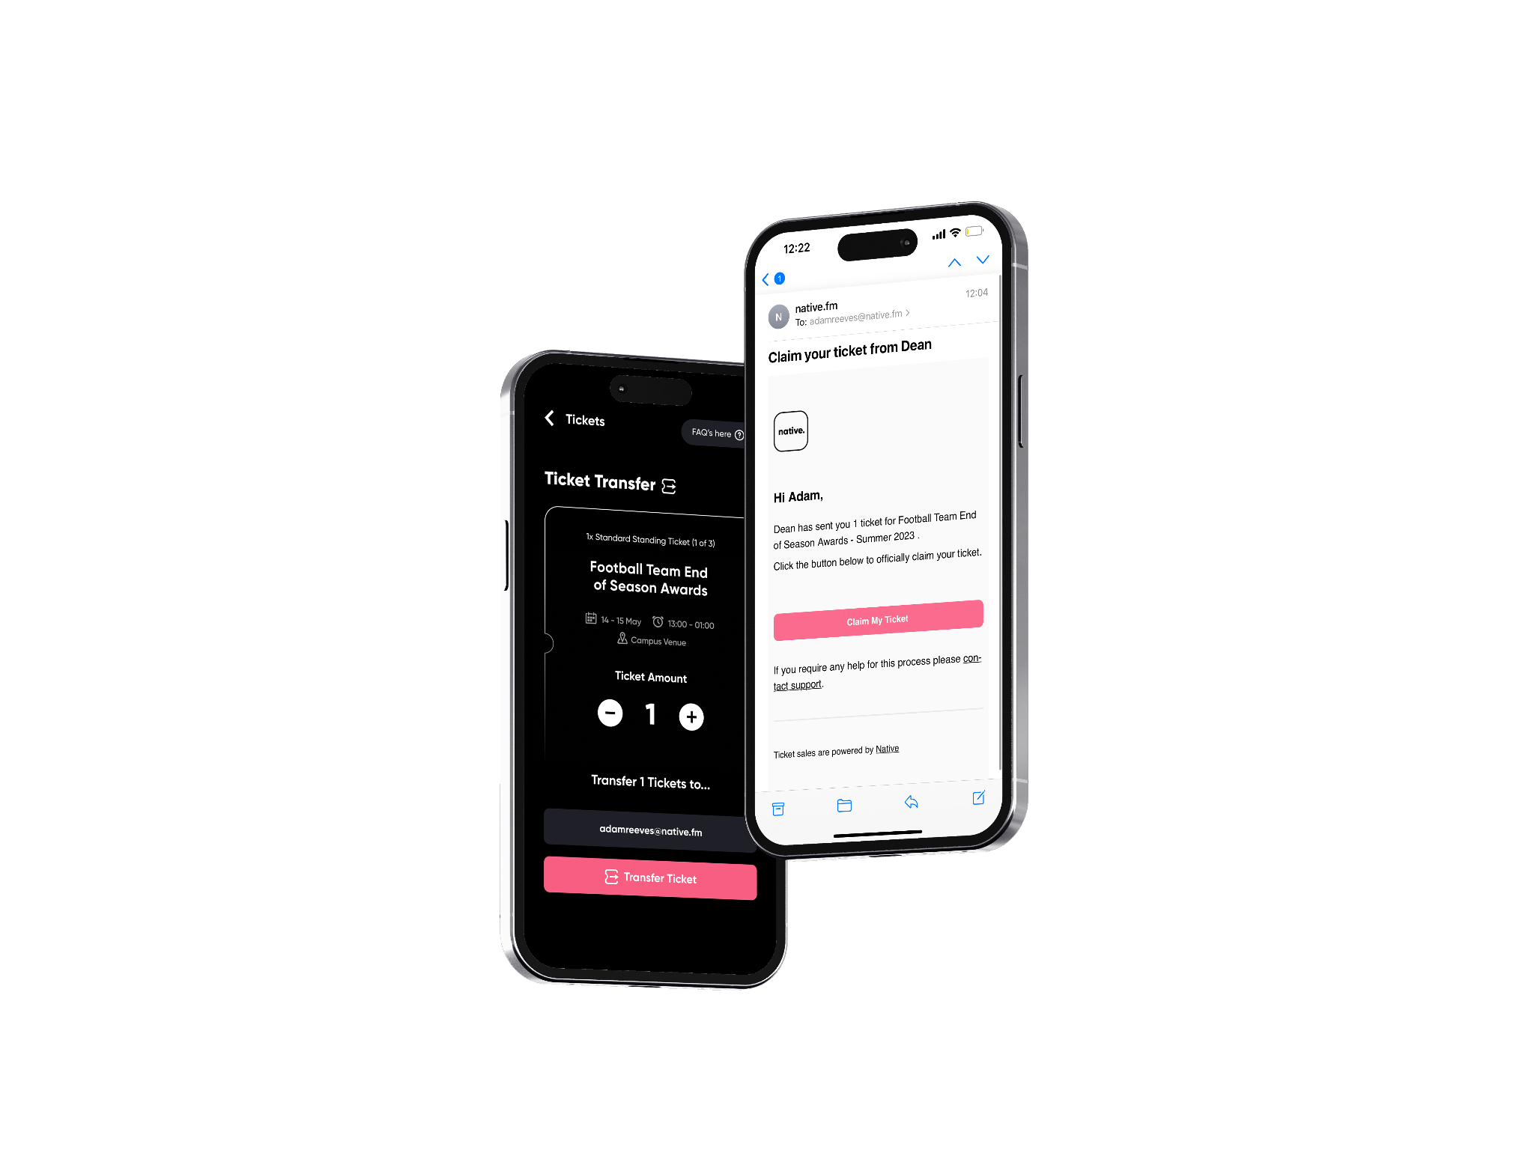
Ticket
Transfers
Ticket Transfer allows users to send one or more tickets to other users directly
You can select which ticket types you want to enable transfers on and also choose where or not its available (e.g. only when tickets have sold out) giving you great control over the process.
‹#›

Slide 22
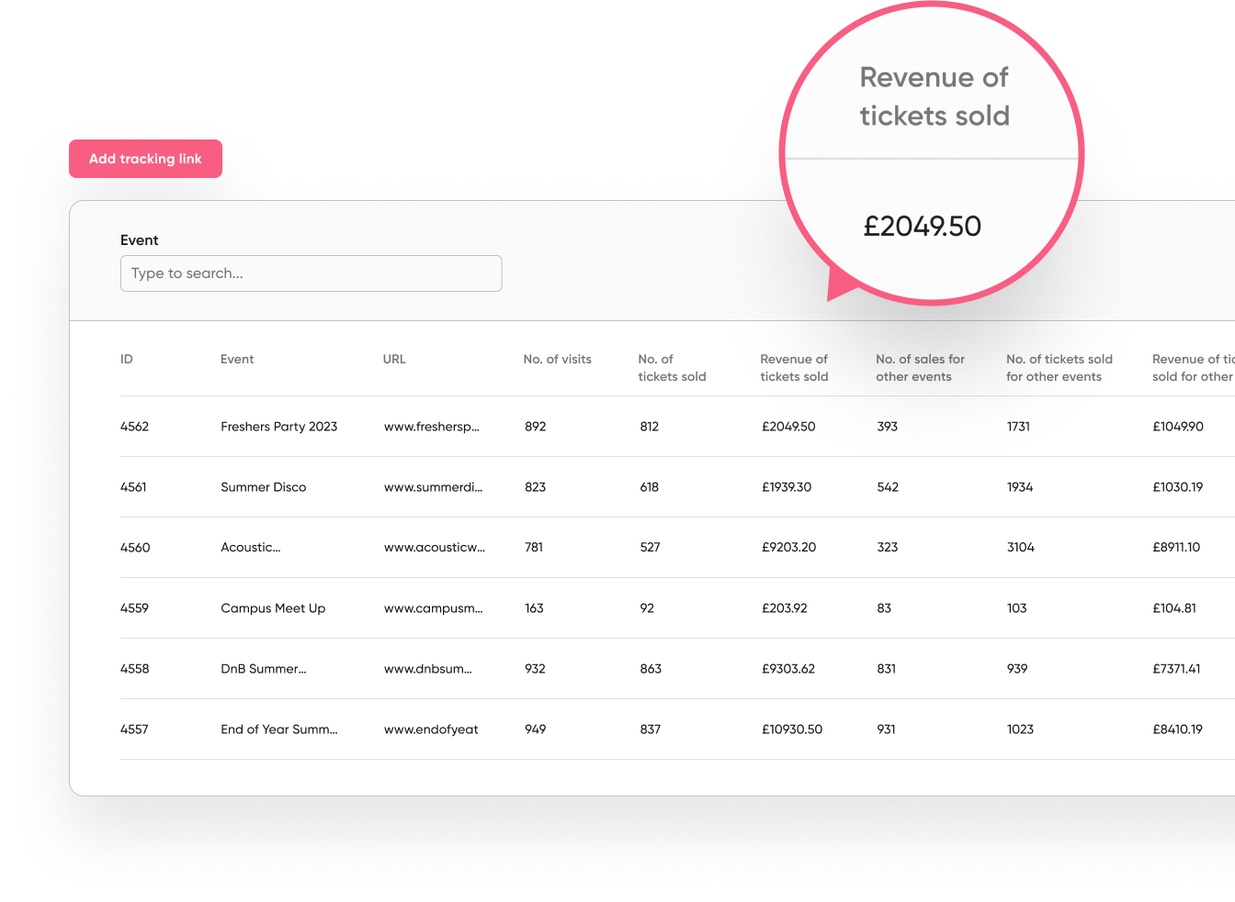
Tracking Links
It’s easier than ever before to report on the effectiveness of your promotional activity with tracking links.
For each event, you’ll be able to understand the number of visits and sales - and revenue - generated through each marketing tactic.
Tracking Links Video Tutorial
‹#›
partner.native.fm
‹#›

Slide 23
Freshers Tech

Slide 24
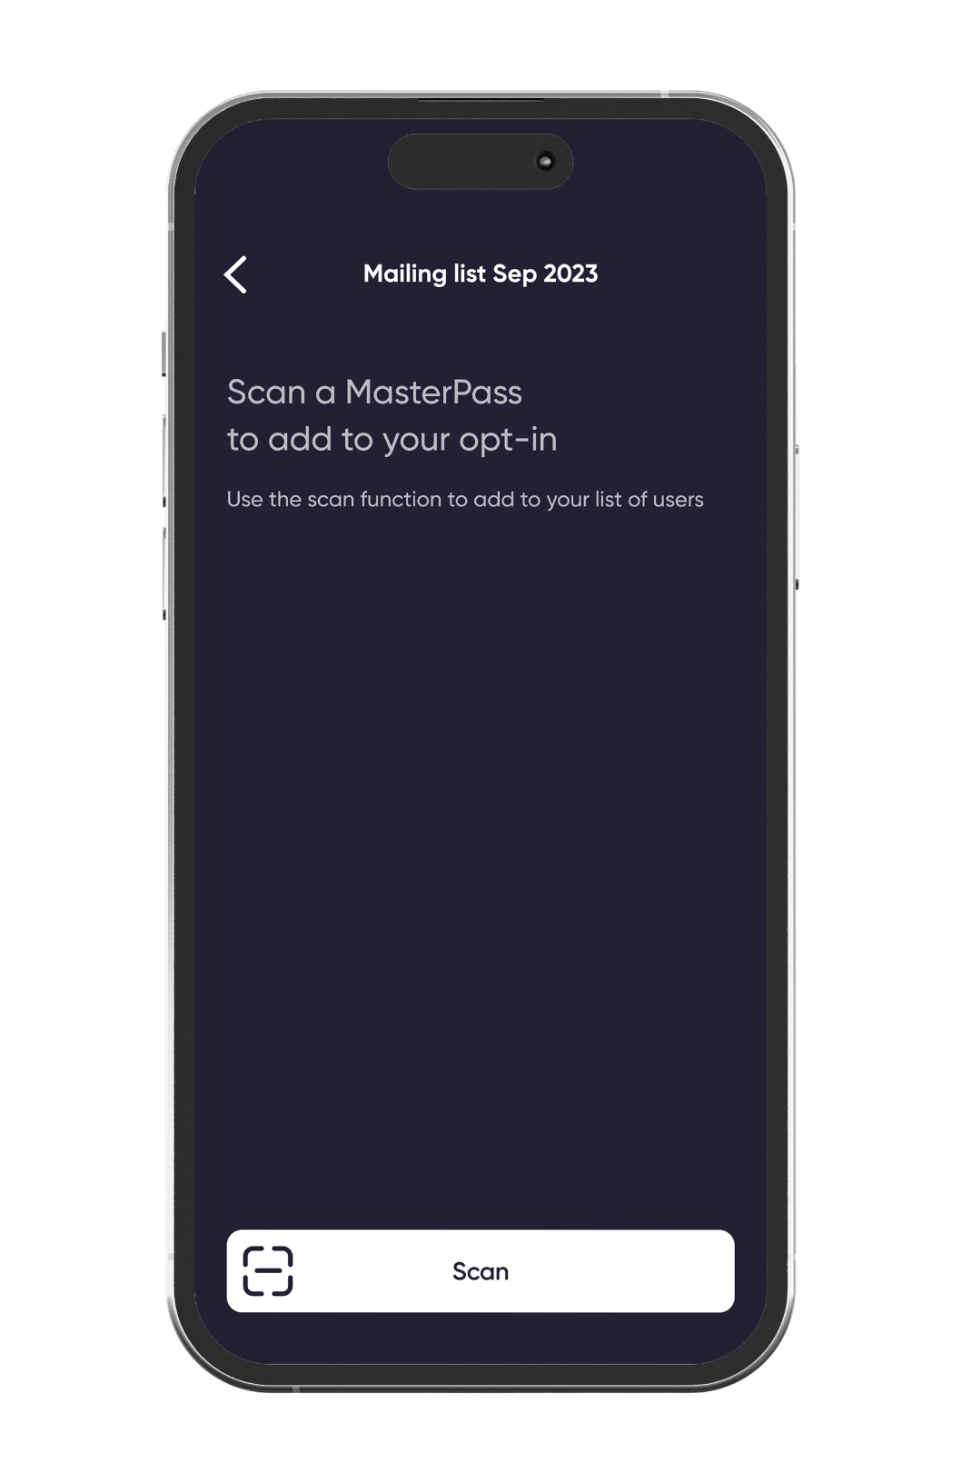
Freshers tech - Student groups
Our Freshers tech provides student groups/clubs & societies with an effortless tool to engage at the fair with students who are interested in their activities.
All they need to do is bring along suitable mobile devices to the fair and scan the students’ MasterPass.
Student groups download our scanning app
You will have been pre-registered with a scanning app account
Students share their details with groups via MasterPass
Student groups will be able to collect fellow student emails in a few taps via our scanning app and student MasterPasses
Opt ins get added to student group followers
Student groups will be able to make the most of our announcement feature as student details will be added to their followers
‹#›
‹#›

Slide 25
Training Links

Slide 26
Platform Training
On-Demand Videos:
Written Tutorials:
native Platform Intro, Activation and Dashboard
native Knowledge Centre
Creating Your First Event on Native
native Scanning App
partner.native.fm
‹#›

Slide 27
Thank you
‹#›

