Slide 1
Welcome to
Committee Training 2024!
hallamstudentsunion.com
@hallamsu_societies

Slide 2
Committee Training 2024 Schedule
Housekeeping and Meet the Societies Team slides
Committee Responsibilities
Events, Trips and Room Bookings
Refreshment break
Native (Events platform)
Health and Safety
Inclusion and Accessibility
Refreshments
Health and Safety
Finances
Elections
Academic Societies
Welcome
Wrap Up
hallamstudentsunion.com
@hallamsu
Notes:
Design idea: swap sections between black and paper white to jazz it up a little. Could use other branding colours as well
Add in an icebreaker at some point

Slide 3
Housekeeping
Our training space today – welcoming environment, ask questions, listen and learn
Committee Essentials Packs – each person has one! Make sure to get out the ‘Essentials’ sheet
In the case of a fire alarm – we aren’t expecting one but if so, go to your nearest emergency exit to leave the building
Toilets – nearest toilet to the Common Room and the Stage are on the same level, in ‘The Den’ (near the pool table)
Devices – phones on silent
If you need anything, please feel free to let us know during refreshment breaks and lunch!
hallamstudentsunion.com
@hallamsu
Notes:
Design idea: swap sections between black and paper white to jazz it up a little. Could use other branding colours as well
Add in an icebreaker at some point

Slide 4
Meet the HSU Societies Team
hallamstudentsunion.com
@hallamsu_societies

Slide 5
HSU Societies Team
Academic Societies Coordinator - Janet Tokitsu
Email: J.Tokitsu@shu.ac.uk
Academic societies are student communities with an academic interest. This could be linked with a specific degree, college and discipline
Supports academic societies with:
Events and Trip proposals
Finance
Society Balls
Risk Assessments
Partnerships with academic university staff
Any other queries
hallamstudentsunion.com
@hallamsu

Slide 6
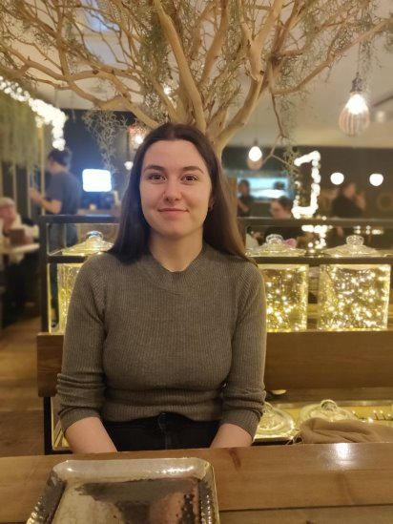
HSU Societies Team
Social Societies Coordinator - Ellen Hardcastle
Email: E.Hardcastle@shu.ac.uk
Social societies are student communities that share a similar interest e.g. Culture and Faith, Performance, Liberation
Supports social societies with:
Events and Trip proposals
Finance
Large scale events such as celebrations, showcases etc.
Risk Assessments
Any other queries
hallamstudentsunion.com
@hallamsu

Slide 7
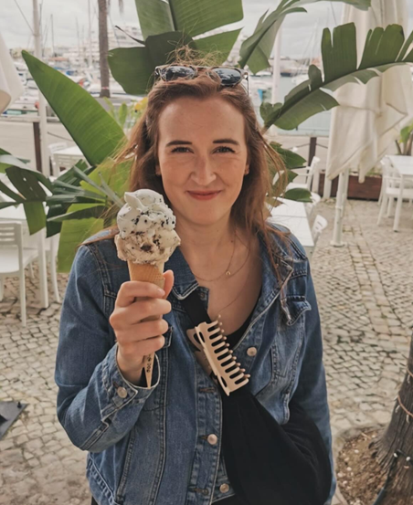
HSU Societies Team
Social and Civic Engagement Manager - Lucy Webber
Supports societies with:
High Risk Societies Training
Health and Safety (Trips)
Strategic development and university partnerships
Big financial stuff/review/approval
hallamstudentsunion.com
@hallamsu

Slide 8
HSU Societies Team
Activities Admin Inbox
If at any point you aren’t sure who to contact, email our shared inbox at activitiesadmin@shu.ac.uk
hallamstudentsunion.com
@hallamsu

Slide 9
Icebreaker
(10 mins)
hallamstudentsunion.com
@hallamsu_societies

Slide 10
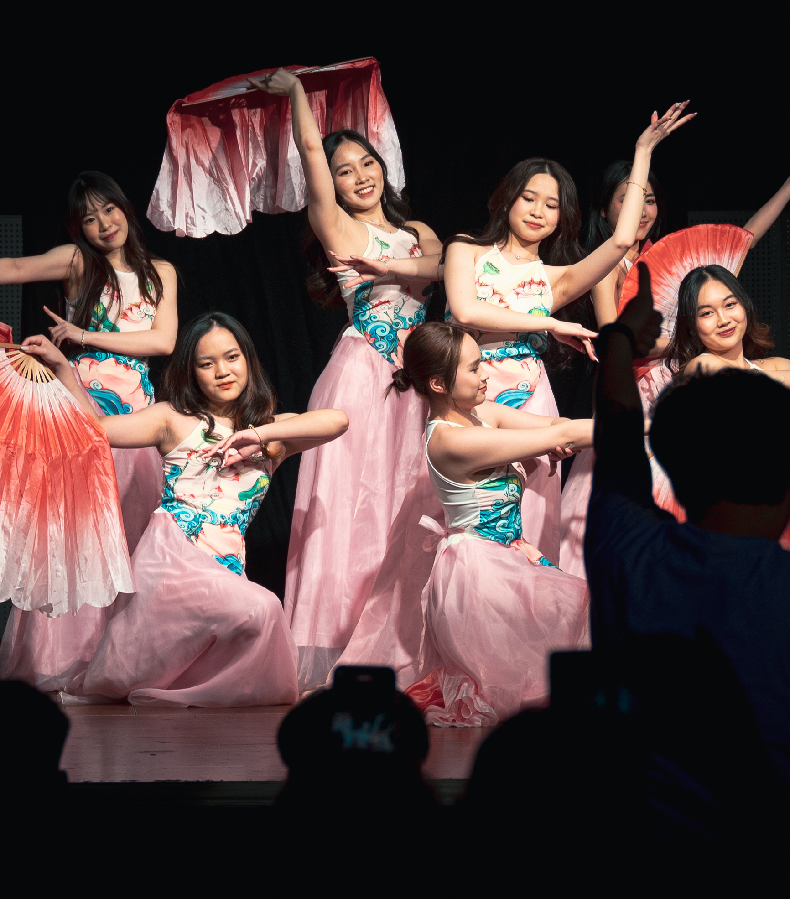
Speak to the person next to you (either in the same society or a different society) and in pairs ask each other:
Name
Degree
Society
Why did you want to be a committee member?
What is one thing you are passionate about?
hallamstudentsunion.com
@hallamsu
Notes:
5-10 mins

Slide 11
Committee Portal
Make use of your Committee Essentials Sheet in your pack!
hallamstudentsunion.com
@hallamsu
Notes:
live demo of the website

Slide 12
Committee Responsibilities
hallamstudentsunion.com
@hallamsu_societies

Slide 13
Committee Responsibilities: Core Paperwork
Two essential pieces of Core Paperwork that every society must complete:
Constitution
This covers who can be a member, society aims and named committee members and positions
Annual Risk Assessment
This covers regular activity of your society
These documents are on the Committee Portal
Deadline to be submitted to the Societies Team: September 22nd 2024
hallamstudentsunion.com
@hallamsu

Slide 14
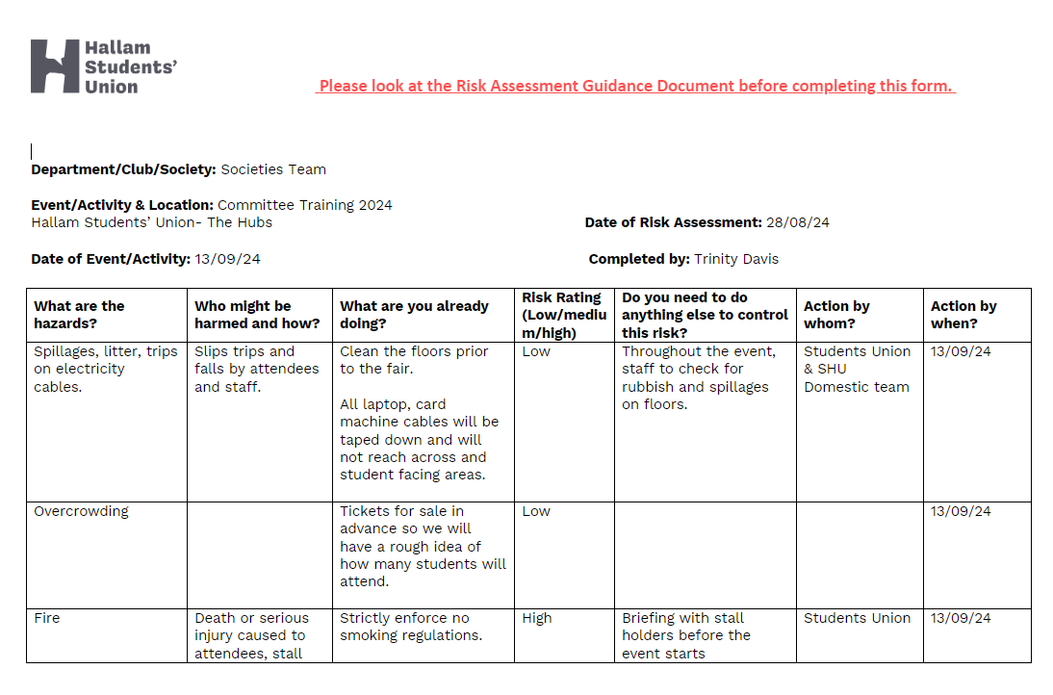
Annual Risk Assessment
hallamstudentsunion.com
@hallamsu

Slide 15
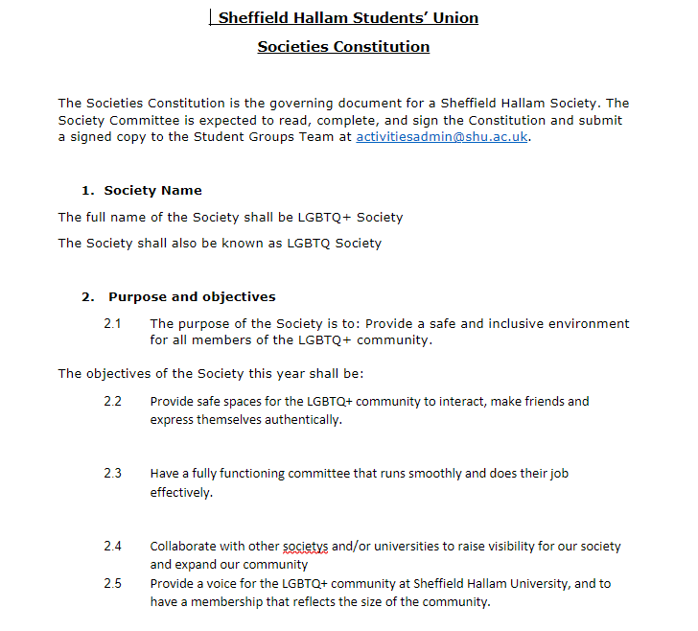
Constitution
hallamstudentsunion.com
@hallamsu

Slide 16
Committee Responsibilities: Annual External Speaker Form
An external speaker is someone who supports society activity (gives talks etc) that is not a Hallam student or member of staff either HSU or the University.
For recurring external speakers (same person), complete this form only once. We have a separate process for event specific external speakers who are only involved once.
Annual External Speaker form is on the Committee Portal
Note: Coach and Instructors will need to complete the Coach and Instructors form (different).
hallamstudentsunion.com
@hallamsu

Slide 17
Committee Responsibilities: Society Email Address
Every society needs an official society email address and it is your responsibility to create this. It can be either Gmail or Outlook.
If you received and can access last year’s email address from your handover: make sure your committee have access to it!
If you didn’t receive one/can’t access it/new society: create one and send this to activitiesadmin@shu.ac.uk
Deadline to be submitted to the Societies Team: September 22nd 2024
hallamstudentsunion.com
@hallamsu

Slide 18
Committee Responsibilities: Society Email Address
Tip: When creating a new society email address, make sure it follows this naming format:
hallam.[insert society name]@gmail.com
or
hallam.[insert society name]@outlook.com
example: hallam.chemistrysoc@gmail.com
hallamstudentsunion.com
@hallamsu
Notes:
please dont include the year in your email address!!!!

Slide 19
Committee Responsibilities: Online Platforms
All open society platforms must be linked through your society webpage to be classed as an official platform.
Committees are responsible for setting up, monitoring and altering society communication channels.
Use our Online Platform and Social Media Use guidance on committee portal to decide which platform is best for you!
hallamstudentsunion.com
@hallamsu
Notes:
please dont include the year in your email address!!!!

Slide 20
Committee Responsibilities: Reflection (10 mins)
As a committee discuss which of the following you have completed:
Annual Risk Assessment
Constitution
Annual External Speaker Form (Optional)
Society email address
Updating your society webpage on the SU website
Use this time to complete and send them to activitiesadmin@shu.ac.uk now if you haven’t already
hallamstudentsunion.com
@hallamsu_societies

Slide 21
Events and Trips Process
hallamstudentsunion.com
@hallamsu_societies

Slide 22
Events and Trips Proposals
Events: Submitted 4 weeks before proposed event date
Day Trips: Submitted 4 weeks before proposed trip date
Overnight and/or abroad Trips: Submitted 8 weeks before proposed trip date
Fill in and submit the Events and Trips Microsoft Form. RA must be attached when submitting.
Outcome will either be: approved/needs more information/rejected
For Trips only: Trip Registration submitted 1 week before
hallamstudentsunion.com
@hallamsu
Notes:
please dont include the year in your email address!!!!

Slide 23
Room Bookings (on campus and HUBS)
Your society's President and Secretary will each have access to Resource Booker which allows them to book rooms across Collegiate Campus.
To book lecture theatres, or spaces at the Students' Union's HUBS building, please contact us at activitiesadmin@shu.ac.uk
hallamstudentsunion.com
@hallamsu
Notes:
please dont include the year in your email address!!!!

Slide 24
Event Spaces at the University
Hosting larger events and stalls on university campus means they have to go through the University Events Process. This requires a minimum of 4 weeks notice to be signed off.
To book an event at the university complete HSU Societies Event Proposal and the Universities event proposal form.
Events within the university should be catered by SHU catering services. We’ve got a bespoke SU menu and 15% discount on orders of other catering.
hallamstudentsunion.com
@hallamsu

Slide 25
Events and Trips: Reflection
Take 5 minutes to discuss: what kind of activities/events/ trips would you like to do this year?
hallamstudentsunion.com
@hallamsu

Slide 26
Refreshment Break
(10 mins)
hallamstudentsunion.com
@hallamsu
Notes:
11:10am

Slide 27
native Events Platform

Slide 28
Native – Events Platform
https://promoters.native.fm/dashboard
Set up with Society Email Address
Event Naming convention – [Society Name] [Society Event]
All society events should be ticketed through Native (even the free ones!)
hallamstudentsunion.com
@hallamsu

Slide 29
Event Listing
You can add lots of different information to your events and easily manage your events on the control panel.
Event Date & Time
Group Page Only
Location - In person or Online
Event Types (Category, Genre, Tags, Artists)
Description and Image
Duplicate & Repeat events
29

Slide 30
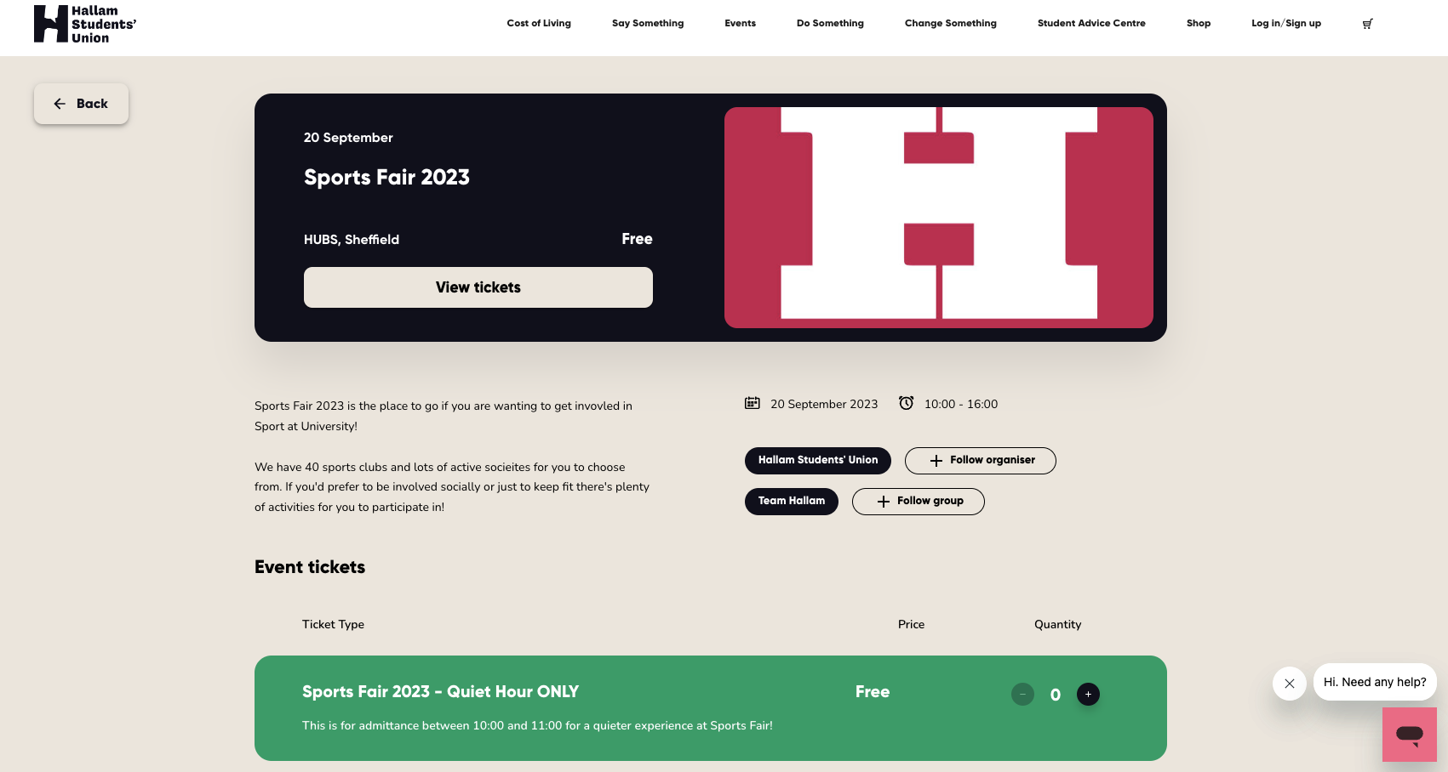
partner.native.fm
30

Slide 31
Tickets

Slide 32
Ticket Creation
Free or paid, ticketing is full of features to help make booking attendance to events easier and better for students. Native allows you to:
Automate Capacity Tracking
Add Ticket Questions
Enable Promo Codes
Allow Ticket Transfers
Set Student & Member Only
Control Ticket Visibility e.g. on sale date or sold out
32

Slide 33
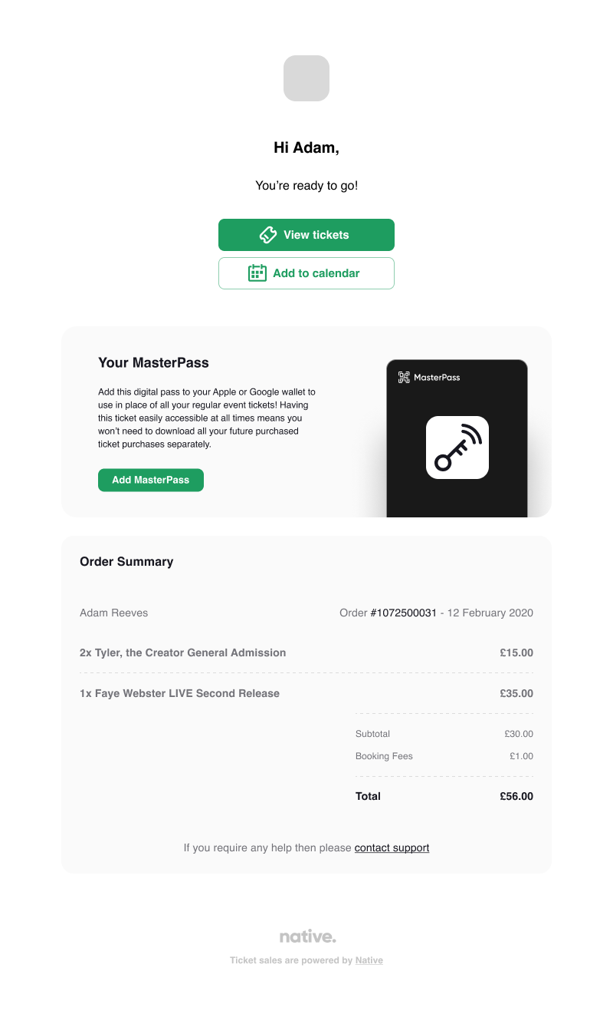
Ticket Purchase
A simple and speedy check out process for students
Confirmation email sent to user
Tickets also accessible via the native account
Master Pass is a unique QR code that can be downloaded to mobile wallets
partner.native.fm
33

Slide 34
Attendance

Slide 35
Native Scanning App
Available for both iOS and Android, is a free tool that allows you to keep track of attendance at your events. You can scan tickets, see real-time attendance analytics, and record who attended after the event finishes. The app also lets you sell box office tickets effortlessly with a few taps.
Once you have activated your account, your login details will work with the scanning app!
partner.native.fm
35

Slide 36
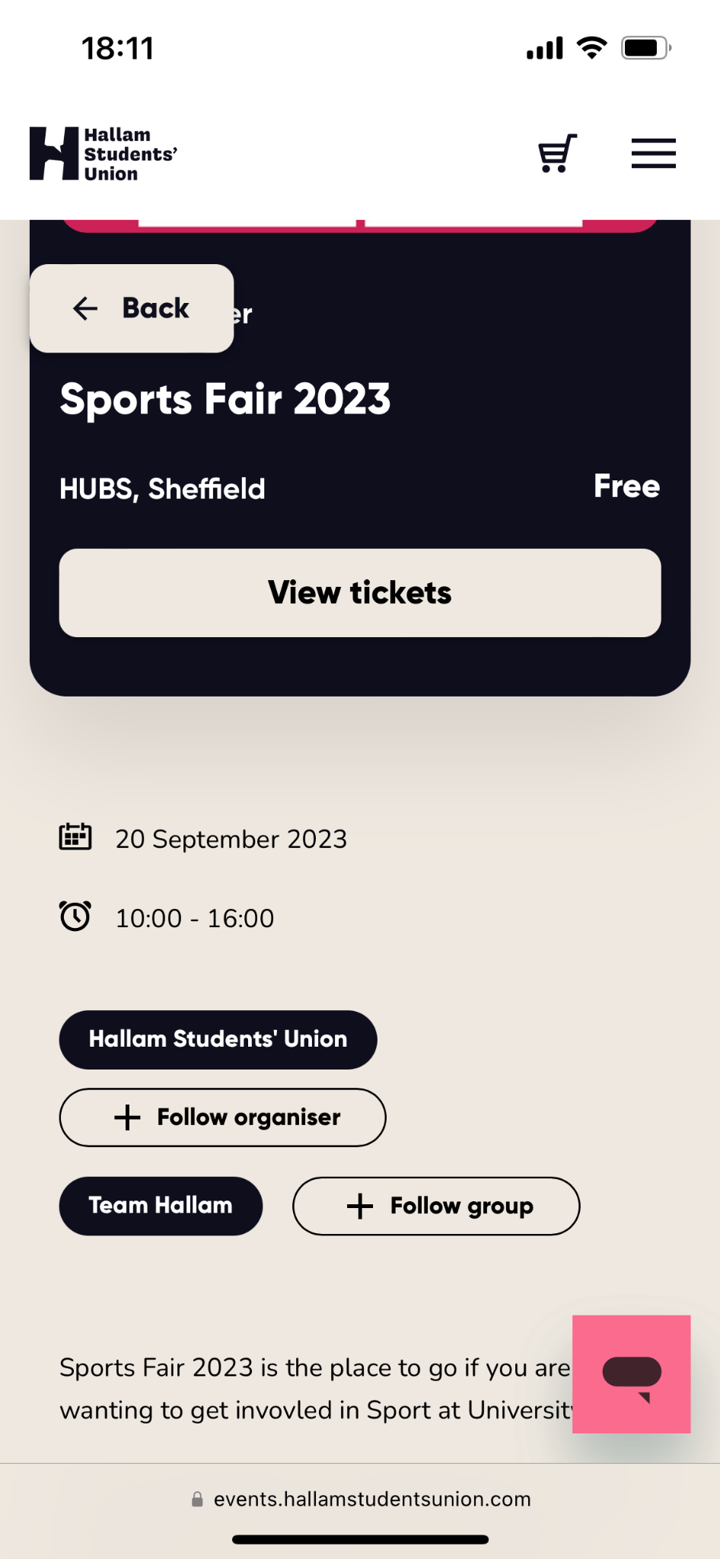
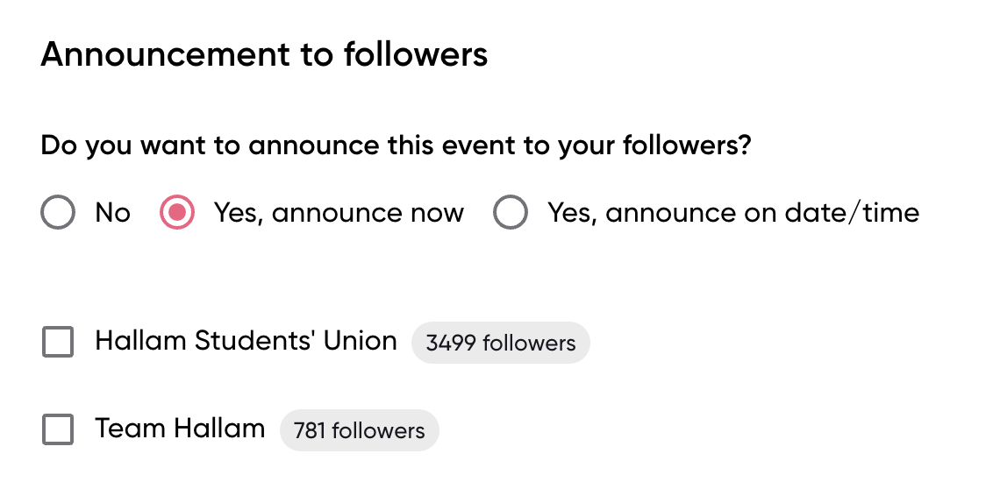
Following
Following is a free marketing tool for you to let your followers know about events you have coming up.
Students will always have the ability to unfollow so your followers will be your most engaged users and a group you can build during freshers to encourage loyalty.
36
partner.native.fm
36

Slide 37
New Notification
Customisable email to your chosen group of users
Previous Notifications
See emails sent in the past as well as who sent them
Notifications
1
2
Notifications are a quick and effective way to alert your chosen group of users out of four groups about service notifications such as a location change or event entry point
native.fm
37

Slide 38
Discussion: Which societies could you collaborate with this year?
hallamstudentsunion.com
@hallamsu

Slide 39
Health and Safety
hallamstudentsunion.com
@hallamsu

Slide 40
Health and Safety
As a committee, you have shared responsibility to ensure that all society activity is carried out in a safe way for all of your members
This means:
Completing the compulsory annual RA
Completing event and trip specific RAs
Being safe and responsible in all society activity
If you are classed as a High Risk society then you have the additional responsibility of:
Having High Risk & First Aid training
Having a Health and Safety Officer
High Risk Training TODAY 1:30-2:30pm in the Stage!
hallamstudentsunion.com
@hallamsu

Slide 41
Risk Assessments
Hazards – The thing that could cause harm
Who & How – who is likely to get hurt and what injuries could happen
Risk – Likelihood vs Severity – Is it high, medium or low risk?
Control Measures – How could you prevent it?
Who is responsible – Who needs to make sure the control measures are in place
Don’t Forget to fill in all the information at the top!
hallamstudentsunion.com
@hallamsu
Notes:
10-15 mins

Slide 42
Inclusion and Accessibility
hallamstudentsunion.com
@hallamsu

Slide 43
Equality, Inclusion and Diversity
All committee members have a responsibility to conduct society activity in an equal and inclusive manner, catering to the diverse needs of your society members.
All society members (inc. committee members) must adhere to the Equality Act 2010, which sets out protected characteristics that cannot be discriminated against. For example: race, age and sexual orientation
Equality and Diversity Officer role: Signposting to resources and escalate concerns to the Societies Team.
EDI Training for Committee Members:
November 5th and 7th 2024
In-person session and an online session
5-7pm
hallamstudentsunion.com
@hallamsu

Slide 44
Accessible Events
Things to consider when planning events:
Consider the physical accessibility of the event, from parking to automatic doors to lift access.
Consider the financial implications of your event, are your tickets reasonably priced?
Consider the level of experience your activity/event requires participants to have.
Do you have enough equipment for your event to be safe?
Is the timing of your event considerate of other commitments participants may have, such as childcare?
Have you shared all the details on the event? Would attendees know what to expect?
Use our Inclusion Guide and Inclusive Events tool on the Committee Portal!
hallamstudentsunion.com
@hallamsu

Slide 45
Refreshment Break
(10 mins)
hallamstudentsunion.com
@hallamsu
Notes:
15 – 20 mins

Slide 46
Society Finances: Basics
hallamstudentsunion.com
@hallamsu

Slide 47
Society Finances – Money!
Every society has one account. It doesn't work like a typical bank account (e.g. there isn't a bank card).
The Treasurer, President, and Secretary are the only people who can authorise spending from this account. They will get email updates letting them know how much is going in and coming out of the account.
All society funds must be kept in this account.
You cannot go overdrawn.
All the money in the account is the society's, we don't take any of this money, and all remaining funds are available the following academic year.
hallamstudentsunion.com
@hallamsu

Slide 48
Society Finances – Claim form or Purchase Order?
Claim forms
We recommend using a claim form for small purchases. A claim form is where you pay for the item yourself and claim the cost back.
They need to be authorised by the President, Secretary, or Treasurer and submitted within three months from the time of expenditure.
Claim forms are digital and proof of purchase must be included for us to authorise it.
hallamstudentsunion.com
@hallamsu

Slide 49
Society Finances – Claim form or Purchase Order?
Purchase orders
A purchase order (PO) is a legal guarantee that your society will pay a supplier a set amount for a product or service.
Using a purchase order
You should use a purchase order for larger purchases such as catering for an event, booking a minibus, etc.
A purchase order is a commitment to paying a supplier/company
Please allow 4 weeks for purchase orders to be raised, approved, processed and paid.
hallamstudentsunion.com
@hallamsu

Slide 50
Society Finances – Money!
You are responsible for overseeing your society income and expenditure. It’s crucial to keep an eye on income and be sure you are increasing it as you need.
There are different ways that your society can generate income:
Your membership price
Fundraising
Funding (for non-regular activity)
Sponsorship
hallamstudentsunion.com
@hallamsu

Slide 51
Society Finances – Funding!
Our funding processes – available on the committee portal
50/50 match basis
hallamstudentsunion.com
@hallamsu

Slide 52
Society Finances – Sponsorship!
Sponsorships are one of the most popular ways societies look to generate income.
For it to be an official sponsorship HSU must see (and approve) the agreement before it is signed. This helps us to make sure you're not accepting any bad deals or taking on personal liability, as well as checking that your deal does not break any of our rules or policies.
Use our template to ensure all the information is included in your agreement (and nothing is sneakily left out!)
hallamstudentsunion.com
@hallamsu

Slide 53
Elections
hallamstudentsunion.com
@hallamsu

Slide 54
Elections
We run bulk Society Committee Elections every year (around March/April).
We do this early to give the outgoing committee enough time to handover to the new committee before summer.
All societies are automatically entered into these elections unless they are newly formed.
In October we run a bulk by-election to fill any gaps or vacancies. Dates for upcoming by-election:
Nominations: 16th September 09:00 – 3rd October 15:00
Manifesto Deadline: 3rd October 15:00
Voting: 14th October 10:00 – 17th October 15:00
If you have any roles that you need adding that are new to the society or an additional role, get in touch with the Societies Team before Monday so we can add it.
hallamstudentsunion.com
@hallamsu

Slide 55
Academic Societies
hallamstudentsunion.com
@hallamsu

Slide 56
Academic Societies
Student-led communities that are centred around a particular subject, academic interest, course or college.
Departmental Funding: This academic year, there may be financial support from the University to give academic society specific funding. We are awaiting confirmation.
Working with Lead Reps: formerly known as Department Reps. One for each School or Institute. Driven to create change and a improve student experience within their areas.
Working with Academics: usually there are specific academics we are in touch with who have an additionally responsibility to support academic societies. They can mass communicate with students to promote the society.
hallamstudentsunion.com
@hallamsu

Slide 57
Welcome 2024
hallamstudentsunion.com
@hallamsu

Slide 58
Welcome 2024
Sports and Societies Fair – 18th September
All confirmed stalls now allocated Waitlist sign up available here.
Society Taster Sessions – 23rd September – 6th October
Deadline to register your taster session 17th September!
Can apply for funding of up to £150 (max £50 for refreshments)
Academic Societies Only – Welcome Socials
hallamstudentsunion.com
@hallamsu

Slide 59
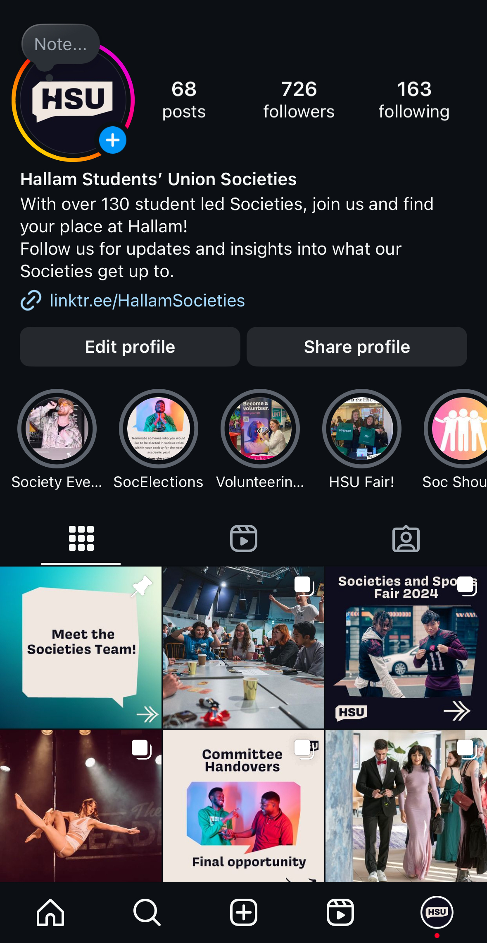
Final Notes!
Committee Training Refresher/Mop Up
When: Tuesday 29th October, 5-7pm
Where: Dorothy Fleming Lecture Theatre
HSU Societies Instagram
Follow and Tag us in your posts!
hallamstudentsunion.com
@hallamsu

Slide 60
Thank you!
Next Up:
Lunch provided in HUBspace
HSU Stalls upstairs for different teams. Take time to talk to the different teams on how they can support your society this year!
After: High Risk Societies Training
1:30pm back in the Stage!
Lunch
hallamstudentsunion.com
@hallamsu

